Slide 1
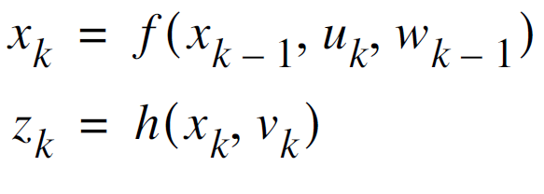
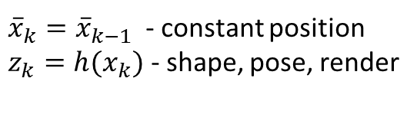
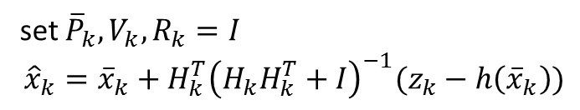

One iteration of LM
Extended Kalman Filter
${\overline{x}}_{k}={\overline{x}}_{k−1}$ - constant position
$z_{k}=h(x_{k})$ - shape, pose, render
$${\hat{x}}_{k}={\overline{x}}_{k}+{{\left(H_{k}^{T}H_{k}+I\right)}^{−1}H}_{k}^{T}(z_{k}−h\left({\overline{x}}_{k}\right))$$
set ${\overline{P}}_{k}, V_{k}, R_{k}=I$
$${\hat{x}}_{k}={\overline{x}}_{k}+H_{k}^{T}{\left(H_{k}H_{k}^{T}+I\right)}^{−1}(z_{k}−h\left({\overline{x}}_{k}\right))$$

Slide 2
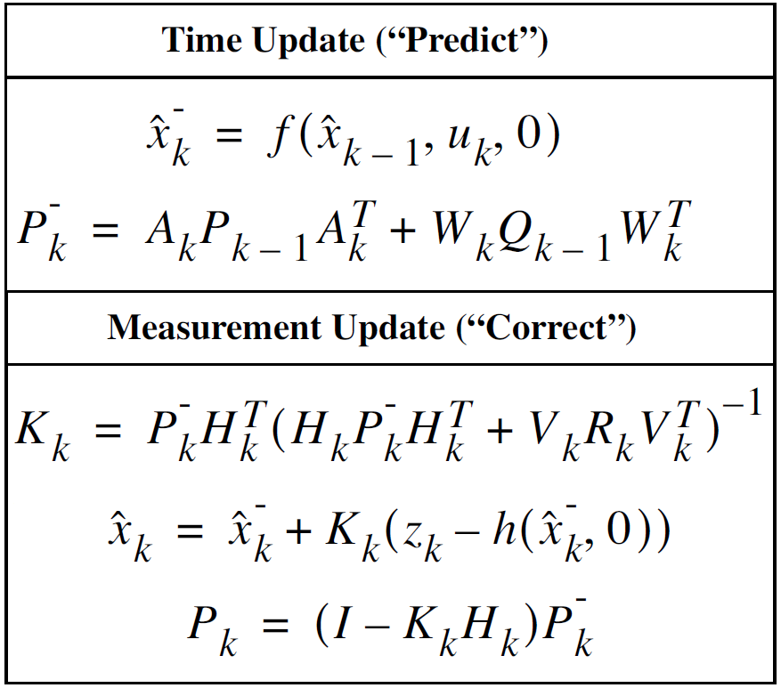
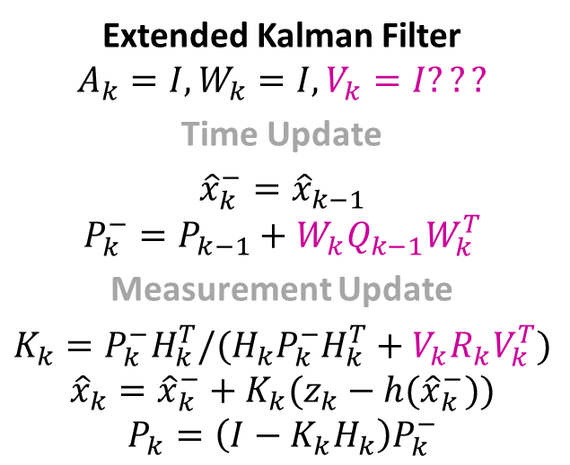
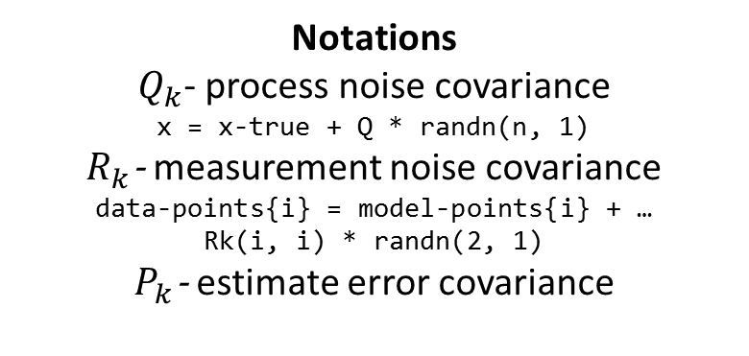
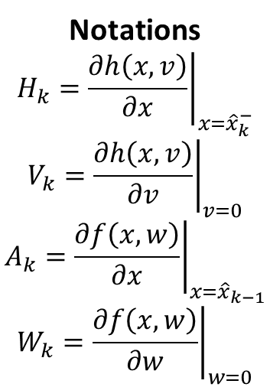
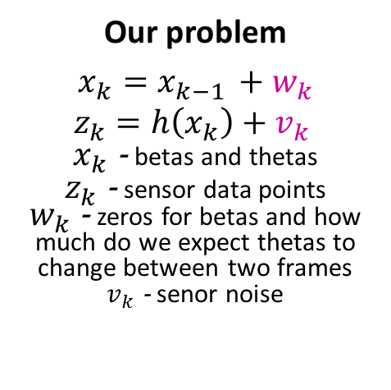
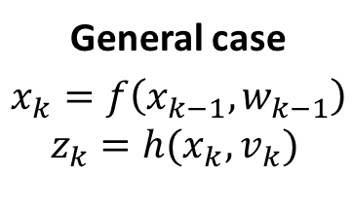
General case
$$x_{k}=f\left(x_{k−1}, w_{k−1}\right)$$
$$z_{k}=h(x_{k}, v_{k})$$
Our problem
$$x_{k}=x_{k−1 }+w_{k}$$
$$z_{k}=h\left(x_{k}\right)+v_{k}$$
$x_{k}$ - betas and thetas
$z_{k}$ - sensor data points
$w_{k}$ - zeros for betas and how much do we expect thetas to change between two frames
$v_{k}$ - senor noise
Notations
$$H_{k}={\left.\frac{∂h\left(x, v\right)}{∂x}\right|}_{x={\hat{x}}_{k}^{−}}$$
$$V_{k}={\left.\frac{∂h\left(x, v\right)}{∂v}\right|}_{v=0}$$
$$A_{k}={\left.\frac{∂f\left(x, w\right)}{∂x}\right|}_{x={\hat{x}}_{k−1}}$$
$$W_{k}={\left.\frac{∂f\left(x, w\right)}{∂w}\right|}_{w=0}$$
Notations
$Q_{k}$- process noise covariance
x = x-true + Q * randn(n, 1)
$R_{k}$- measurement noise covariance
data-points{i} = model-points{i} + …
Rk(i, i) * randn(2, 1)
$P_{k}$- estimate error covariance
Extended Kalman Filter
$$A_{k}=I, {W_{k}=I, V}_{k}=I???$$
Time Update
$${\hat{x}}_{k}^{−}={\hat{x}}_{k−1}$$
$$P_{k}^{−}=P_{k−1}+{W_{k}Q}_{k−1}W_{k}^{T}$$
Measurement Update
$$K_{k}=P_{k}^{−}H_{k}^{T}/{(H_{k}P}_{k}^{−}H_{k}^{T}+{V_{k}R}_{k}V_{k}^{T})$$
$${\hat{x}}_{k}={\hat{x}}_{k}^{−}+K_{k}(z_{k}−h({\hat{x}}_{k}^{−}))$$
$$P_{k}=\left(I−K_{k}H_{k}\right)P_{k}^{−}$$

Slide 3
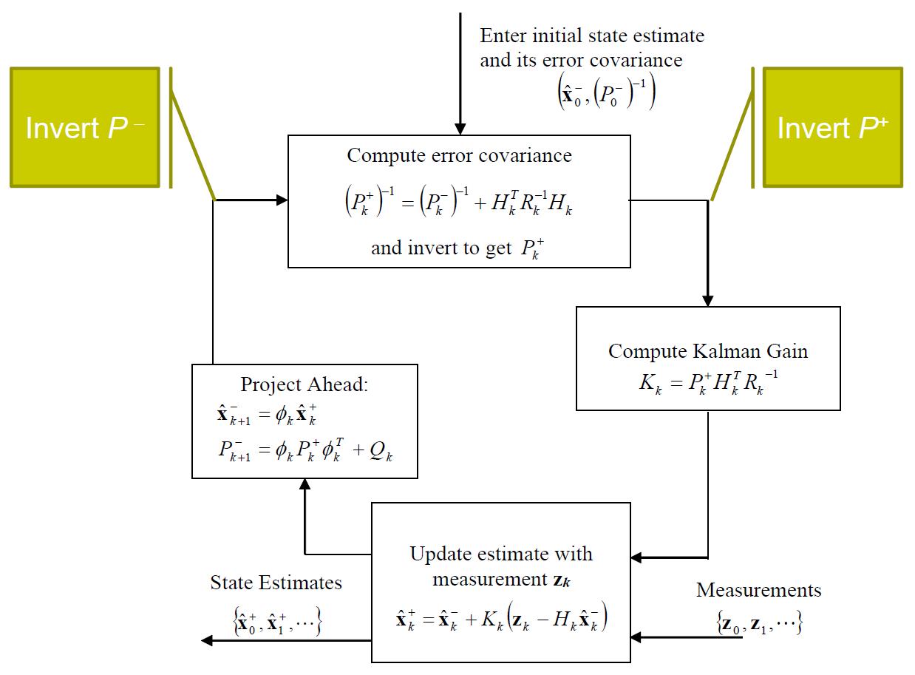

Slide 4
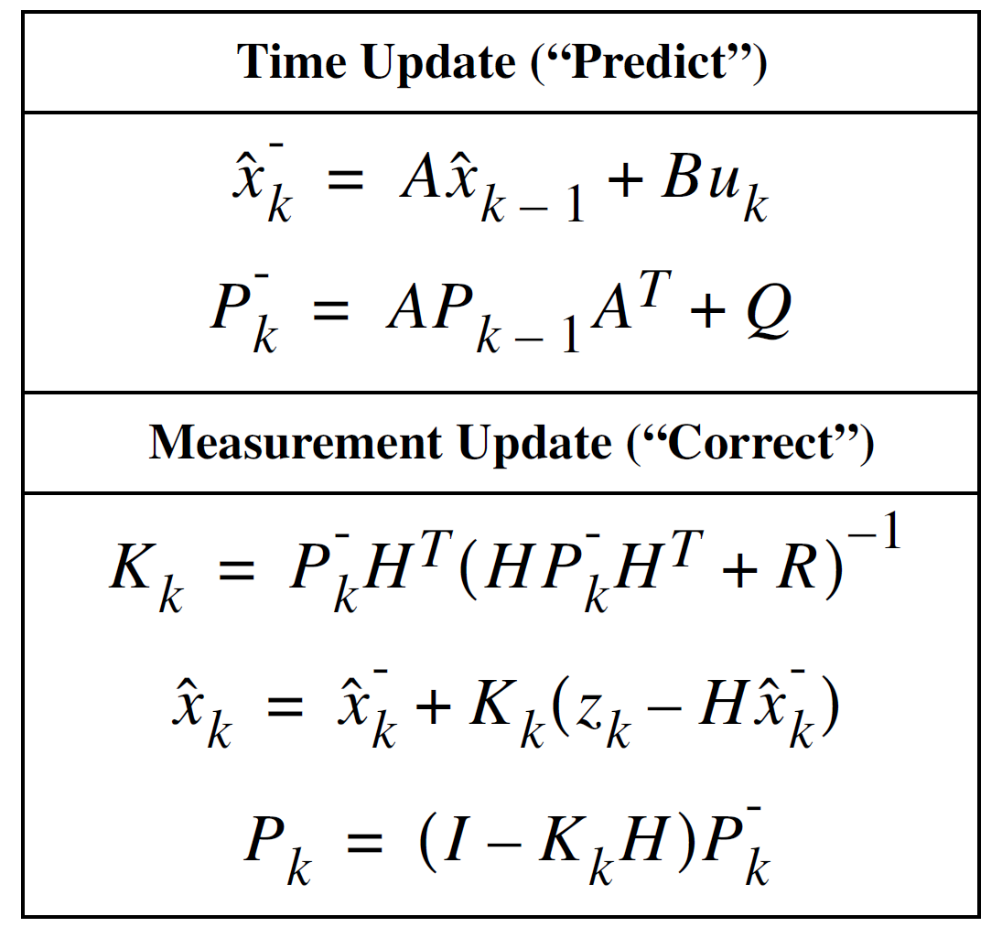
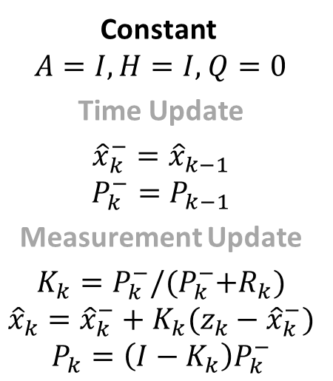
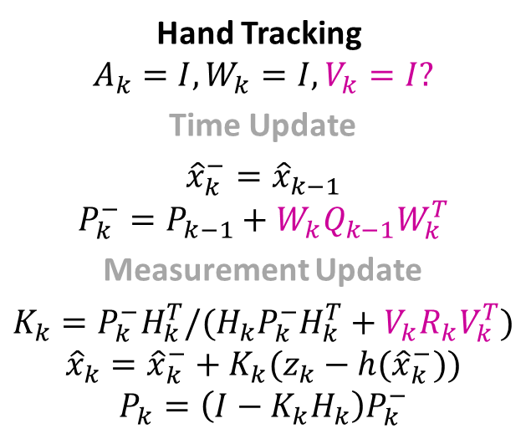
Constant
$A=I, H=I,$ $Q=0$
Time Update
$${\hat{x}}_{k}^{−}={\hat{x}}_{k−1}$$
$$P_{k}^{−}=P_{k−1}$$
Measurement Update
$$K_{k}=P_{k}^{−}/{(P}_{k}^{−}+R_{k})$$
$${\hat{x}}_{k}={\hat{x}}_{k}^{−}+K_{k}(z_{k}−{\hat{x}}_{k}^{−})$$
$$P_{k}=\left(I−K_{k}\right)P_{k}^{−}$$
Hand Tracking
$$A_{k}=I, {W_{k}=I, V}_{k}=I?$$
Time Update
$${\hat{x}}_{k}^{−}={\hat{x}}_{k−1}$$
$$P_{k}^{−}=P_{k−1}+{W_{k}Q}_{k−1}W_{k}^{T}$$
Measurement Update
$$K_{k}=P_{k}^{−}H_{k}^{T}/{(H_{k}P}_{k}^{−}H_{k}^{T}+{V_{k}R}_{k}V_{k}^{T})$$
$${\hat{x}}_{k}={\hat{x}}_{k}^{−}+K_{k}(z_{k}−h({\hat{x}}_{k}^{−}))$$
$$P_{k}=\left(I−K_{k}H_{k}\right)P_{k}^{−}$$

Slide 5
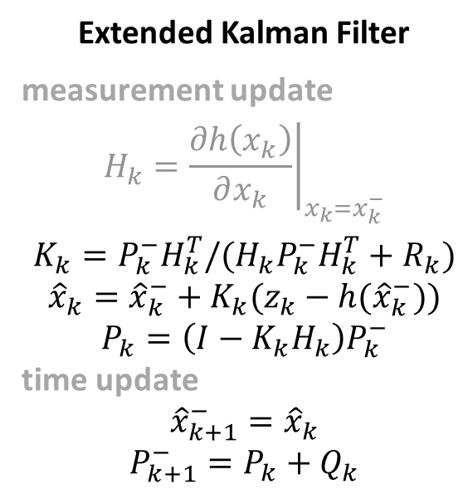
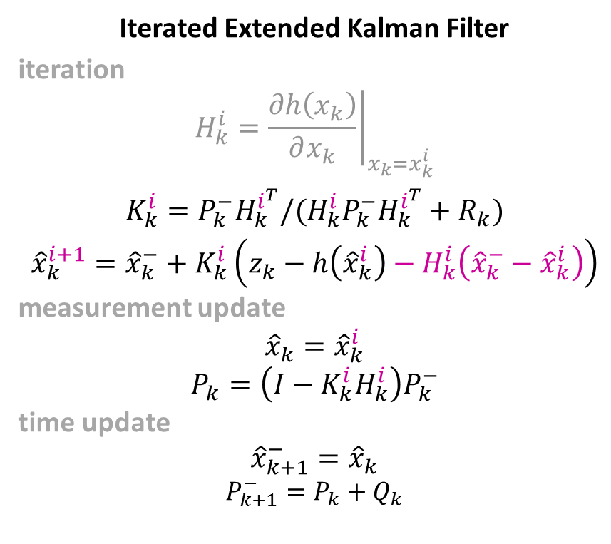
Extended Kalman Filter
measurement update
$$H_{k}={\left.\frac{∂h\left(x_{k}\right)}{∂x_{k}}\right|}_{x_{k}=x_{k}^{−}}$$
$$K_{k}=P_{k}^{−}H_{k}^{T}/{(H_{k}P}_{k}^{−}H_{k}^{T}+R_{k})$$
$${\hat{x}}_{k}={\hat{x}}_{k}^{−}+K_{k}(z_{k}−h({\hat{x}}_{k}^{−}))$$
$$P_{k}=\left(I−K_{k}H_{k}\right)P_{k}^{−}$$
time update
$${\hat{x}}_{k+1}^{−}={\hat{x}}_{k}$$
$$P_{k+1}^{−}=P_{k}+Q_{k}$$
Iterated Extended Kalman Filter
iteration
$$H_{k}^{i}={\left.\frac{∂h\left(x_{k}\right)}{∂x_{k}}\right|}_{x_{k}=x_{k}^{i}}$$
$$K_{k}^{i}=P_{k}^{−}H_{k}^{i^{T}}/{(H_{k}^{i}P}_{k}^{−}H_{k}^{i^{T}}+R_{k})$$
$${\hat{x}}_{k}^{i+1}={\hat{x}}_{k}^{−}+K_{k}^{i}\left(z_{k}−h\left({\hat{x}}_{k}^{i}\right)−H_{k}^{i}\left({\hat{x}}_{k}^{−}−{\hat{x}}_{k}^{i}\right)\right)$$
measurement update
$${\hat{x}}_{k}={\hat{x}}_{k}^{i}$$
$$P_{k}=\left(I−K_{k}^{i}H_{k}^{i}\right)P_{k}^{−}$$
time update
$${\hat{x}}_{k+1}^{−}={\hat{x}}_{k}$$
$$P_{k+1}^{−}=P_{k}+Q_{k}$$

Slide 6
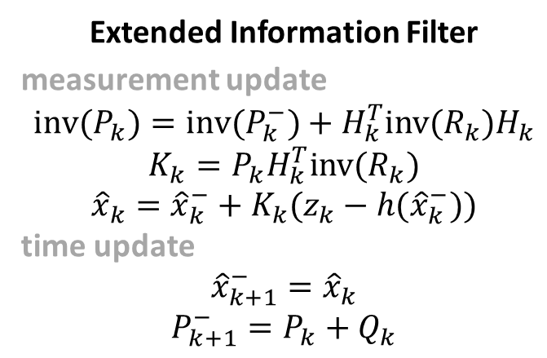
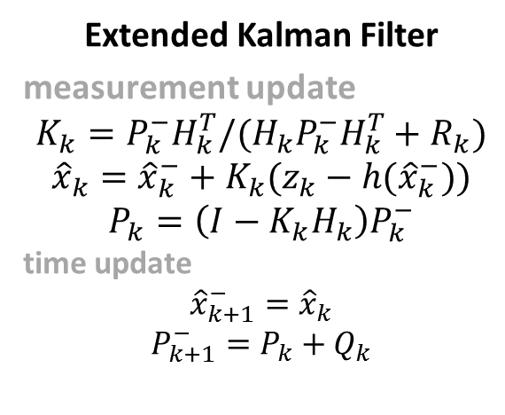
Extended Kalman Filter
measurement update
$$K_{k}=P_{k}^{−}H_{k}^{T}/{(H_{k}P}_{k}^{−}H_{k}^{T}+R_{k})$$
$${\hat{x}}_{k}={\hat{x}}_{k}^{−}+K_{k}(z_{k}−h({\hat{x}}_{k}^{−}))$$
$$P_{k}=\left(I−K_{k}H_{k}\right)P_{k}^{−}$$
time update
$${\hat{x}}_{k+1}^{−}={\hat{x}}_{k}$$
$$P_{k+1}^{−}=P_{k}+Q_{k}$$
Extended Information Filter
measurement update
$${inv(P}_{k})={inv(P}_{k}^{−})+H_{k}^{T}inv(R_{k})H_{k}$$
$$K_{k}=P_{k}H_{k}^{T}inv(R_{k})$$
$${\hat{x}}_{k}={\hat{x}}_{k}^{−}+K_{k}(z_{k}−h({\hat{x}}_{k}^{−}))$$
time update
$${\hat{x}}_{k+1}^{−}={\hat{x}}_{k}$$
$$P_{k+1}^{−}=P_{k}+Q_{k}$$

Slide 7
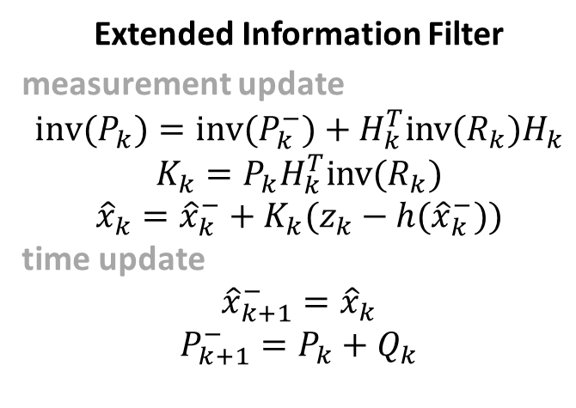
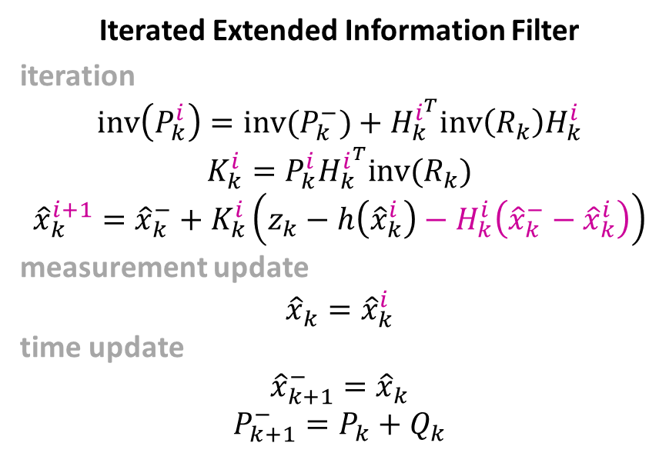
Extended Information Filter
measurement update
$${inv(P}_{k})={inv(P}_{k}^{−})+H_{k}^{T}inv(R_{k})H_{k}$$
$$K_{k}=P_{k}H_{k}^{T}inv(R_{k})$$
$${\hat{x}}_{k}={\hat{x}}_{k}^{−}+K_{k}(z_{k}−h({\hat{x}}_{k}^{−}))$$
time update
$${\hat{x}}_{k+1}^{−}={\hat{x}}_{k}$$
$$P_{k+1}^{−}=P_{k}+Q_{k}$$
Iterated Extended Information Filter
iteration
$${inv\left(P_{k}^{i}\right)=inv(P}_{k}^{−})+H_{k}^{i^{T}}inv\left(R_{k}\right)H_{k}^{i}$$
$$K_{k}^{i}=P_{k}^{i}H_{k}^{i^{T}}inv(R_{k})$$
$${\hat{x}}_{k}^{i+1}={\hat{x}}_{k}^{−}+K_{k}^{i}\left(z_{k}−h\left({\hat{x}}_{k}^{i}\right)−H_{k}^{i}\left({\hat{x}}_{k}^{−}−{\hat{x}}_{k}^{i}\right)\right)$$
measurement update
$${\hat{x}}_{k}={\hat{x}}_{k}^{i}$$
time update
$${\hat{x}}_{k+1}^{−}={\hat{x}}_{k}$$
$$P_{k+1}^{−}=P_{k}+Q_{k}$$

Slide 8
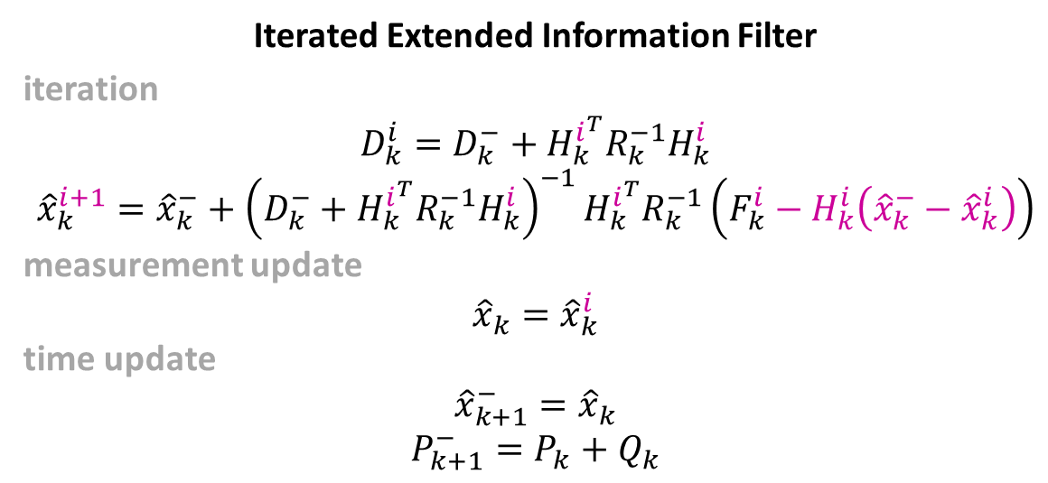
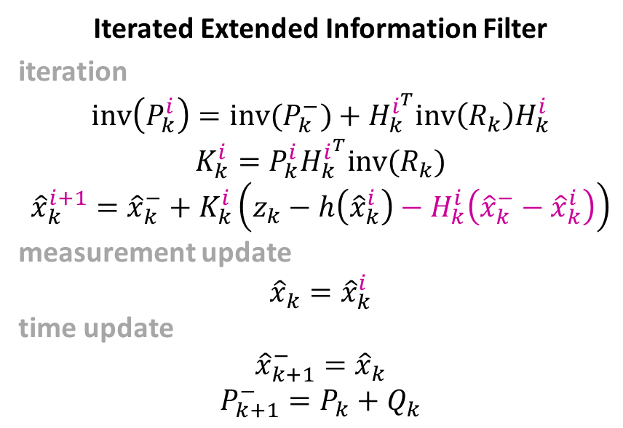
Iterated Extended Information Filter
iteration
$${inv\left(P_{k}^{i}\right)=inv(P}_{k}^{−})+H_{k}^{i^{T}}inv\left(R_{k}\right)H_{k}^{i}$$
$$K_{k}^{i}=P_{k}^{i}H_{k}^{i^{T}}inv(R_{k})$$
$${\hat{x}}_{k}^{i+1}={\hat{x}}_{k}^{−}+K_{k}^{i}\left(z_{k}−h\left({\hat{x}}_{k}^{i}\right)−H_{k}^{i}\left({\hat{x}}_{k}^{−}−{\hat{x}}_{k}^{i}\right)\right)$$
measurement update
$${\hat{x}}_{k}={\hat{x}}_{k}^{i}$$
time update
$${\hat{x}}_{k+1}^{−}={\hat{x}}_{k}$$
$$P_{k+1}^{−}=P_{k}+Q_{k}$$
Iterated Extended Information Filter
iteration
$${D_{k}^{i}=D}_{k}^{−}+H_{k}^{i^{T}}R_{k}^{−1}H_{k}^{i}$$
$${\hat{x}}_{k}^{i+1}={\hat{x}}_{k}^{−}+{\left(D_{k}^{−}+H_{k}^{i^{T}}R_{k}^{−1}H_{k}^{i}\right)}^{−1}H_{k}^{i^{T}}R_{k}^{−1}\left(F_{k}^{i}−H_{k}^{i}\left({\hat{x}}_{k}^{−}−{\hat{x}}_{k}^{i}\right)\right)$$
measurement update
$${\hat{x}}_{k}={\hat{x}}_{k}^{i}$$
time update
$${\hat{x}}_{k+1}^{−}={\hat{x}}_{k}$$
$$P_{k+1}^{−}=P_{k}+Q_{k}$$

Slide 9
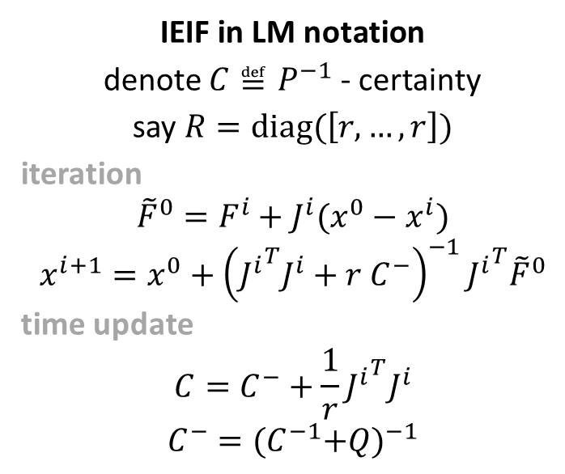
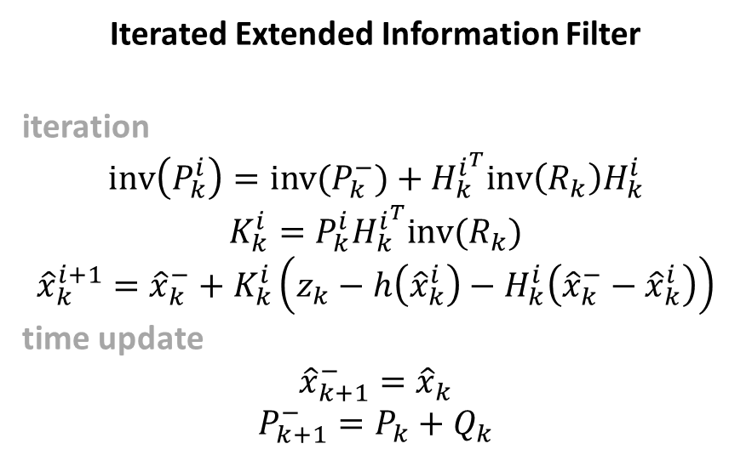
Iterated Extended Information Filter
iteration
$${inv\left(P_{k}^{i}\right)=inv(P}_{k}^{−})+H_{k}^{i^{T}}inv\left(R_{k}\right)H_{k}^{i}$$
$$K_{k}^{i}=P_{k}^{i}H_{k}^{i^{T}}inv(R_{k})$$
$${\hat{x}}_{k}^{i+1}={\hat{x}}_{k}^{−}+K_{k}^{i}\left(z_{k}−h\left({\hat{x}}_{k}^{i}\right)−H_{k}^{i}\left({\hat{x}}_{k}^{−}−{\hat{x}}_{k}^{i}\right)\right)$$
time update
$${\hat{x}}_{k+1}^{−}={\hat{x}}_{k}$$
$$P_{k+1}^{−}=P_{k}+Q_{k}$$
IEIF in LM notation
denote $C≝P^{−1}$ - certainty
say $R=diag(\left[r, …, r\right])$
iteration
$${\tilde{F}}^{0}=F^{i}+J^{i}(x^{0}−x^{i})$$
$$x^{i+1}=x^{0}+{\left({J^{i}}^{T}J^{i}+r C^{−}\right)}^{−1}{J^{i}}^{T}{\tilde{F}}^{0}$$
time update
$$C=C^{−}+\frac{1}{r}{J^{i}}^{T}J^{i}$$
$$C^{−}={{(C}^{−1}+Q)}^{−1}$$

Slide 10
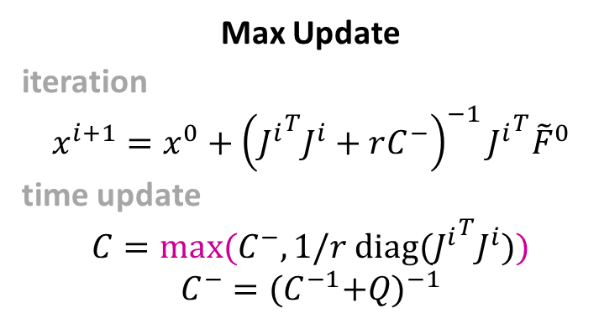
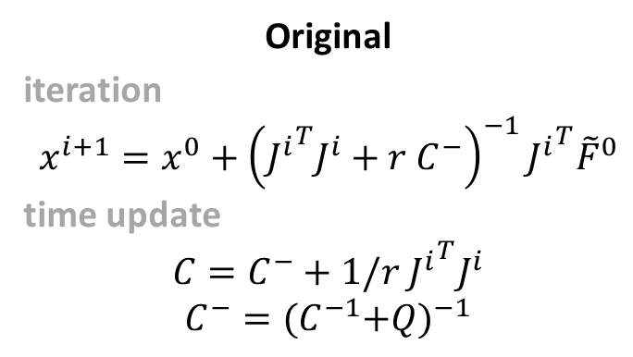
Original
iteration
$$x^{i+1}=x^{0}+{\left({J^{i}}^{T}J^{i}+r C^{−}\right)}^{−1}{J^{i}}^{T}{\tilde{F}}^{0}$$
time update
$$C=C^{−}+1/r{{ J}^{i}}^{T}J^{i}$$
$$C^{−}={{(C}^{−1}+Q)}^{−1}$$
Max Update
iteration
$$x^{i+1}=x^{0}+{\left({J^{i}}^{T}J^{i}+rC^{−}\right)}^{−1}{J^{i}}^{T}{\tilde{F}}^{0}$$
time update
$$C={max⁡(C}^{−}, 1/r{{ diag(J}^{i}}^{T}J^{i}))$$
$$C^{−}={{(C}^{−1}+Q)}^{−1}$$

Slide 11
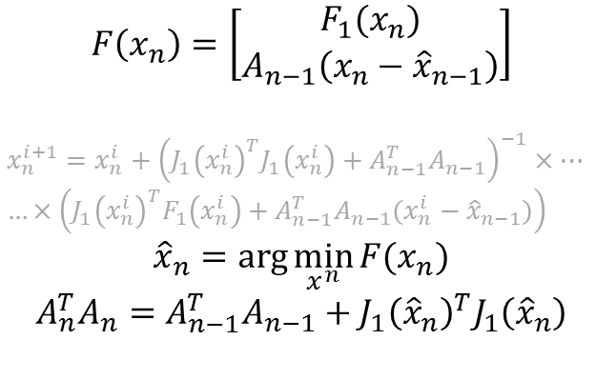
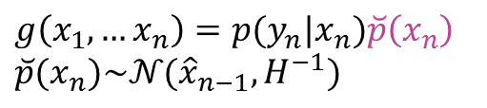

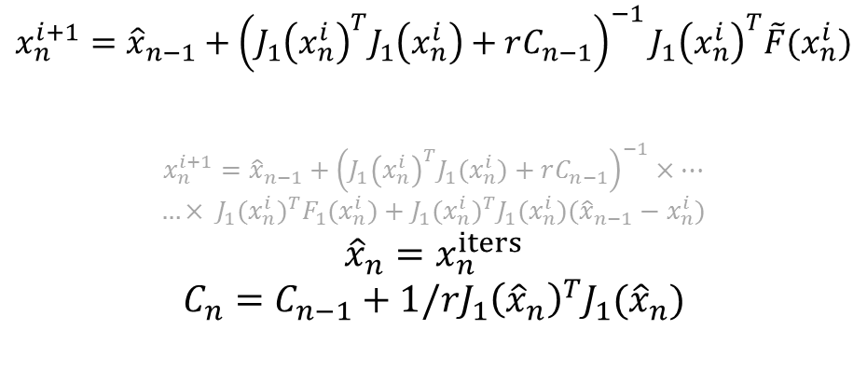
Iterated Extended Kalman Filter
New recursive maximization
$$F\left(x_{n}\right)=\left[\begin{matrix}F_{1}(x_{n}) \\ A_{n−1}\left(x_{n}−{\hat{x}}_{n−1}\right)\end{matrix}\right]$$
$$x_{n}^{i+1}=x_{n}^{i}+{\left(J_{1}{\left(x_{n}^{i}\right)}^{T}J_{1}\left(x_{n}^{i}\right)+A_{n−1}^{T}A_{n−1}\right)}^{−1}×…$$
$$…×\left({J_{1}\left(x_{n}^{i}\right)}^{T}F_{1}\left(x_{n}^{i}\right)+A_{n−1}^{T}A_{n−1}(x_{n}^{i}−{\hat{x}}_{n−1})\right)$$
$${\hat{x}}_{n}=\arg{\min_{x^{n}}{F(x_{n})}}$$
$$A_{n}^{T}A_{n}=A_{n−1}^{T}A_{n−1}+J_{1}{\left({\hat{x}}_{n}\right)}^{T}J_{1}\left({\hat{x}}_{n}\right)$$
$$x_{n}^{i+1}={\hat{x}}_{n−1}+{\left(J_{1}{\left(x_{n}^{i}\right)}^{T}J_{1}\left(x_{n}^{i}\right)+rC_{n−1}\right)}^{−1}J_{1}{\left(x_{n}^{i}\right)}^{T}\tilde{F}(x_{n}^{i})$$
$$x_{n}^{i+1}={\hat{x}}_{n−1}+{\left(J_{1}{\left(x_{n}^{i}\right)}^{T}J_{1}(x_{n}^{i})+rC_{n−1}\right)}^{−1}×…$$
$…× {J_{1}(x_{n}^{i})}^{T}F_{1}(x_{n}^{i})+{J_{1}(x_{n}^{i})}^{T}J_{1}(x_{n}^{i})({\hat{x}}_{n−1}−x_{n}^{i})$
$${\hat{x}}_{n}=x_{n}^{iters}$$
$$C_{n}=C_{n−1}+1/rJ_{1}{\left({\hat{x}}_{n}\right)}^{T}J_{1}({\hat{x}}_{n})$$
$$A_{n}^{T}A_{n}=rC_{n}$$
$g\left(x_{1},…x_{n}\right)=p(y_{n}|x_{n})\breve{p}\left(x_{n}\right)$
$\breve{p}(x_{n})\sim 𝒩({\hat{x}}_{n−1}, H^{−1})$

Slide 12
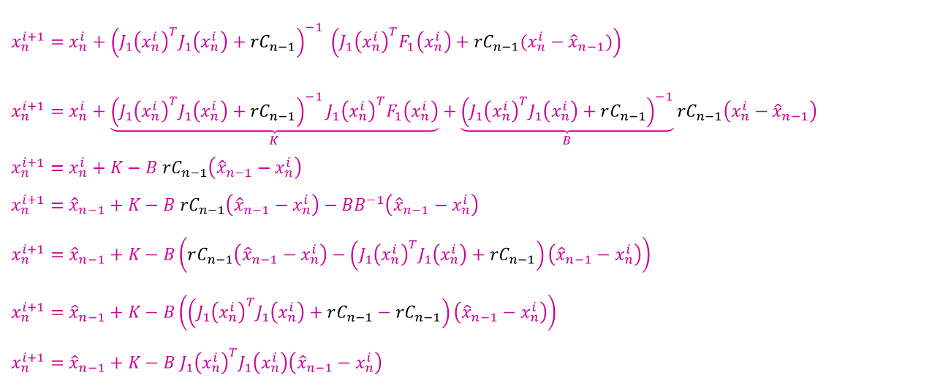
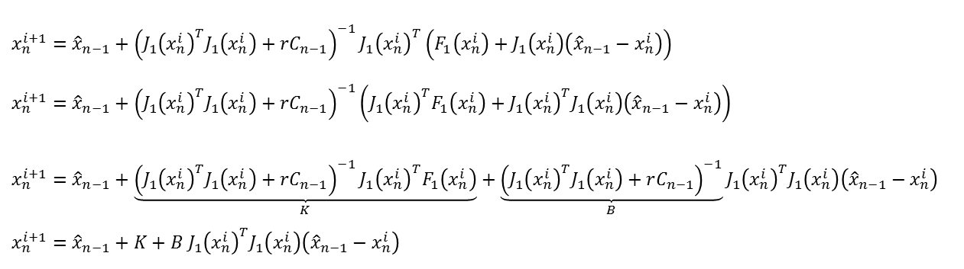
Iterated Extended Kalman Filter
$x_{n}^{i+1}={\hat{x}}_{n−1}+{\left(J_{1}{\left(x_{n}^{i}\right)}^{T}J_{1}\left(x_{n}^{i}\right)+rC_{n−1}\right)}^{−1}{J_{1}\left(x_{n}^{i}\right)}^{T}\left(F_{1}\left(x_{n}^{i}\right)+J_{1}\left(x_{n}^{i}\right)\left({\hat{x}}_{n−1}−x_{n}^{i}\right)\right)$
$x_{n}^{i+1}={\hat{x}}_{n−1}+{\left(J_{1}{\left(x_{n}^{i}\right)}^{T}J_{1}\left(x_{n}^{i}\right)+rC_{n−1}\right)}^{−1}\left({{J_{1}\left(x_{n}^{i}\right)}^{T}F}_{1}\left(x_{n}^{i}\right)+{{J_{1}\left(x_{n}^{i}\right)}^{T}J}_{1}\left(x_{n}^{i}\right)\left({\hat{x}}_{n−1}−x_{n}^{i}\right)\right)$
$x_{n}^{i+1}={\hat{x}}_{n−1}+\underset{K}{\underbrace{{\left(J_{1}{\left(x_{n}^{i}\right)}^{T}J_{1}\left(x_{n}^{i}\right)+rC_{n−1}\right)}^{−1}{{J_{1}\left(x_{n}^{i}\right)}^{T}F}_{1}\left(x_{n}^{i}\right)}}+\underset{B}{\underbrace{{\left(J_{1}{\left(x_{n}^{i}\right)}^{T}J_{1}\left(x_{n}^{i}\right)+rC_{n−1}\right)}^{−1}}}{{J_{1}\left(x_{n}^{i}\right)}^{T}J}_{1}\left(x_{n}^{i}\right)\left({\hat{x}}_{n−1}−x_{n}^{i}\right)$
$x_{n}^{i+1}={\hat{x}}_{n−1}+K+B {{J_{1}\left(x_{n}^{i}\right)}^{T}J}_{1}\left(x_{n}^{i}\right)\left({\hat{x}}_{n−1}−x_{n}^{i}\right)$
New recursive maximization
$$x_{n}^{i+1}=x_{n}^{i}+{\left(J_{1}{\left(x_{n}^{i}\right)}^{T}J_{1}\left(x_{n}^{i}\right)+rC_{n−1}\right)}^{−1} \left({J_{1}\left(x_{n}^{i}\right)}^{T}F_{1}\left(x_{n}^{i}\right)+rC_{n−1}(x_{n}^{i}−{\hat{x}}_{n−1})\right)$$
$$x_{n}^{i+1}=x_{n}^{i}+\underset{K}{\underbrace{{\left(J_{1}{\left(x_{n}^{i}\right)}^{T}J_{1}\left(x_{n}^{i}\right)+rC_{n−1}\right)}^{−1}{J_{1}\left(x_{n}^{i}\right)}^{T}F_{1}\left(x_{n}^{i}\right)}}+\underset{B}{\underbrace{{\left(J_{1}{\left(x_{n}^{i}\right)}^{T}J_{1}\left(x_{n}^{i}\right)+rC_{n−1}\right)}^{−1}}}rC_{n−1}\left(x_{n}^{i}−{\hat{x}}_{n−1}\right)$$
$$x_{n}^{i+1}=x_{n}^{i}+K−B rC_{n−1}\left({{\hat{x}}_{n−1}−x}_{n}^{i}\right)$$
$$x_{n}^{i+1}={\hat{x}}_{n−1}+K−B rC_{n−1}\left({{\hat{x}}_{n−1}−x}_{n}^{i}\right)−BB^{−1}\left({{\hat{x}}_{n−1}−x}_{n}^{i}\right)$$
$$x_{n}^{i+1}={\hat{x}}_{n−1}+K−B\left(rC_{n−1}\left({{\hat{x}}_{n−1}−x}_{n}^{i}\right)−\left(J_{1}{\left(x_{n}^{i}\right)}^{T}J_{1}\left(x_{n}^{i}\right)+rC_{n−1}\right)\left({{\hat{x}}_{n−1}−x}_{n}^{i}\right)\right)$$
$$x_{n}^{i+1}={\hat{x}}_{n−1}+K−B\left(\left(J_{1}{\left(x_{n}^{i}\right)}^{T}J_{1}\left(x_{n}^{i}\right)+rC_{n−1}−rC_{n−1}\right)\left({{\hat{x}}_{n−1}−x}_{n}^{i}\right)\right)$$
$$x_{n}^{i+1}={\hat{x}}_{n−1}+K−B J_{1}{\left(x_{n}^{i}\right)}^{T}J_{1}\left(x_{n}^{i}\right)\left({{\hat{x}}_{n−1}−x}_{n}^{i}\right)$$

Slide 13
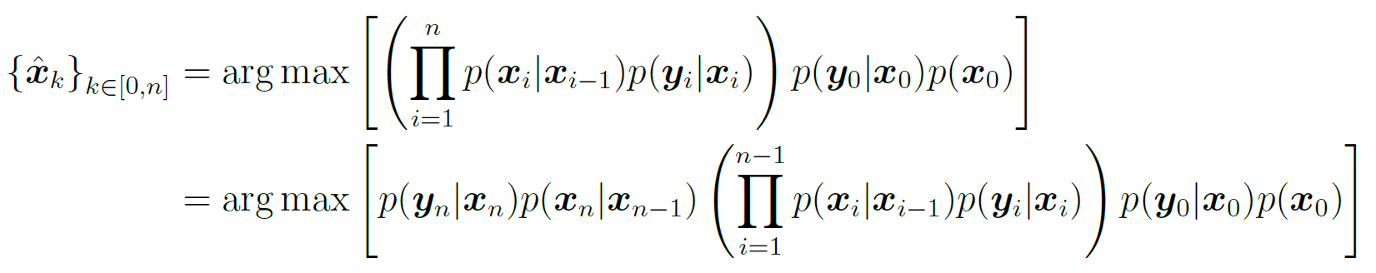
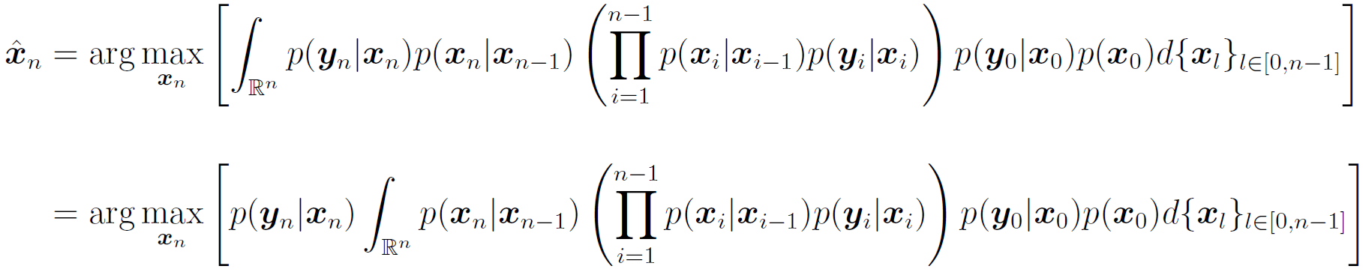

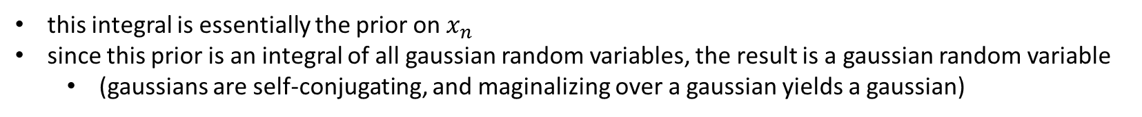
Bayesian Derivation of Kalman Filter – Part 1
after marginalization
$$\underset{p_{{\hat{x}}_{n−1}}\left(x_{n}\right)}{\underbrace{ }}$$
this integral is essentially the prior on $x_{n}$
since this prior is an integral of all gaussian random variables, the result is a gaussian random variable
(gaussians are self-conjugating, and maginalizing over a gaussian yields a gaussian)
$${\hat{x}}_{n}=\arg{\max_{x_{n}}\left[p\left(y_{n} | x_{n}\right)p_{{\hat{x}}_{n−1}}\left(x_{n}\right)\right]}$$

Slide 14
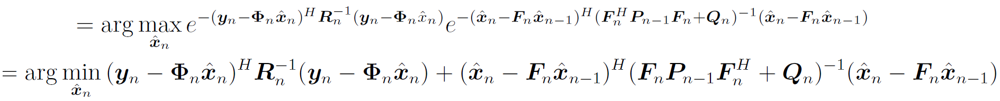



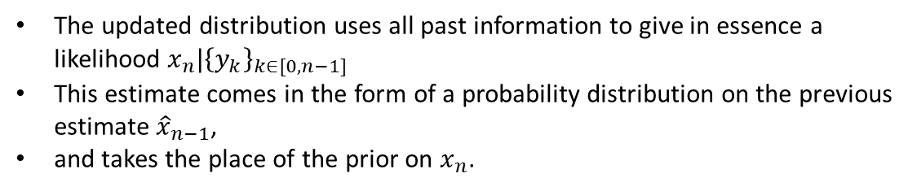
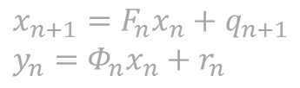



Bayesian Derivation of Kalman Filter – Part 2
$${\hat{x}}_{n}$$
$$\underset{p\left(x_{n}\right)}{\underbrace{ }}$$
$${\hat{x}}_{n}=\arg{\max_{x_{n}}\left[p\left(y_{n} | x_{n}\right) p\left(x_{n}\right)\right]}$$
The Kalman equations can then be derived by using a MAP estimate:
$${\hat{x}}_{n}=\arg{\max_{{\hat{x}}_{n}}\left[p\left(y_{n} | {\hat{x}}_{n}\right) p\left({\hat{x}}_{n}\right)\right]}$$
The updated distribution uses all past information to give in essence a likelihood $x_{n}|{\left\{y_{k}\right\}}_{k∈[0, n−1]}$
This estimate comes in the form of a probability distribution on the previous estimate ${\hat{x}}_{n−1}$,
and takes the place of the prior on $x_{n}$.
$x_{n+1}=F_{n}x_{n}+q_{n+1}$
$y_{n}=Φ_{n}x_{n}+r_{n}$
$$p\left({\hat{x}}_{n}\right)=𝒩\left(F_{n}{\hat{x}}_{n−1}, F_{n}P_{n−1}F_{n}^{T}+Q_{n}\right)$$
$$p\left(y_{n}|{\hat{x}}_{n}\right)=𝒩\left(Φ_{n}{\hat{x}}_{n}, R_{n}\right)$$
$${\hat{x}}_{n}=\arg{\max_{{\hat{x}}_{n}}\left[p\left(y_{n} | {\hat{x}}_{n}\right) p\left({\hat{x}}_{n}\right)\right]=}$$

Slide 15

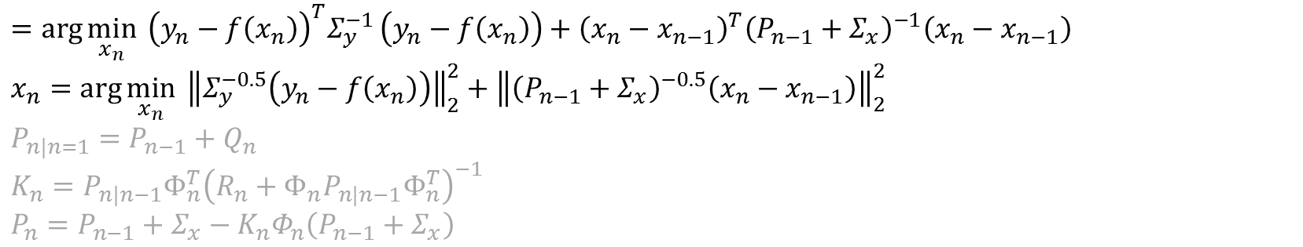


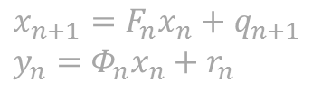
Bayesian Derivation of Kalman Filter – Part 3
$x_{n+1}=F_{n}x_{n}+q_{n+1}$
$y_{n}=Φ_{n}x_{n}+r_{n}$
$$p\left({\hat{x}}_{n}\right)=𝒩\left(F_{n}{\hat{x}}_{n−1}, F_{n}P_{n−1}F_{n}^{T}+Q_{n}\right)$$
$$p\left(y_{n}|{\hat{x}}_{n}\right)=𝒩\left(Φ_{n}{\hat{x}}_{n}, R_{n}\right)$$
$${\hat{x}}_{n}=\arg{\max_{{\hat{x}}_{n}}\left[p\left(y_{n} | {\hat{x}}_{n}\right) p\left({\hat{x}}_{n}\right)\right]=}$$
$$=\arg{\min_{x_{n}}{{ \left(y_{n}−f\left(x_{n}\right)\right)}^{T}Σ_{y}^{−1}}}\left(y_{n}−f\left(x_{n}\right)\right)+{\left(x_{n}−x_{n−1}\right)}^{T}{\left(P_{n−1}+Σ_{x}\right)}^{−1}\left(x_{n}−x_{n−1}\right)$$
$$x_{n}=\arg{\min_{x_{n}}{ {\left\|Σ_{y}^{−0.5}\left(y_{n}−f\left(x_{n}\right)\right)\right\|}_{2}^{2}}}+{\left\|{\left(P_{n−1}+Σ_{x}\right)}^{−0.5}\left(x_{n}−x_{n−1}\right)\right\|}_{2}^{2}$$
$$P_{n|n=1}=P_{n−1}+Q_{n}$$
$$K_{n}=P_{n|n−1}Φ_{n}^{T}{\left(R_{n}+Φ_{n}P_{n|n−1}Φ_{n}^{T}\right)}^{−1}$$
$P_{n}=P_{n−1}+Σ_{x}−K_{n}Φ_{n}\left(P_{n−1}+Σ_{x}\right)$

Slide 16

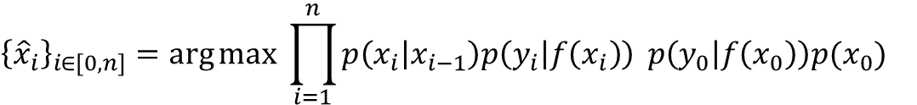

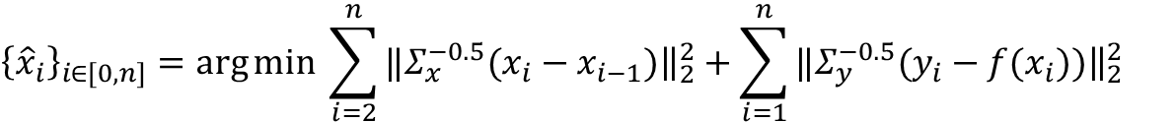
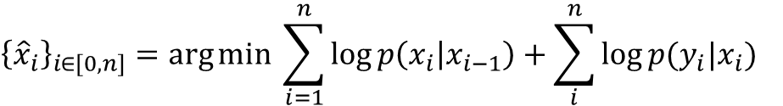
Bayesian Derivation of Batch Optimization
$${\left\{{\hat{x}}_{i}\right\}}_{i∈[0, n]}=\arg{\max{\prod_{i=1}^{n}{p\left(x_{i} | x_{i−1}\right)p\left(y_{i} | f\left(x_{i}\right)\right)}} p\left(y_{0} | f\left(x_{0}\right)\right)p(x_{0})}$$
$$p\left(x_{i}|x_{i−1}\right)=𝒩\left(x_{i}|μ=x_{i−1}, Σ_{x}\right)$$
$$p\left(y_{i}|f(x_{i})\right)=𝒩\left(y_{i}\left|μ={f(x}_{i}\right), Σ_{f}\right)$$
$${\left\{{\hat{x}}_{i}\right\}}_{i∈[0, n]}=\arg{\min{\sum_{i=1}^{n}{\log{p\left(x_{i} | x_{i−1}\right)}+\sum_{i}^{n}{\log{p(y_{i}|x_{i})}}}}}$$
$${\left\{{\hat{x}}_{i}\right\}}_{i∈[0, n]}=\arg{\min{\sum_{i=1}^{n}{C_{1}{\left(x_{i}−\overset{μ}{\overbrace{x_{i−1}}}\right)}^{T}Σ_{x}^{−1}\left(x_{i}−\overset{μ}{\overbrace{x_{i−1}}}\right)+\sum_{i}^{n}{C_{2}{\left(y_{i}−\overset{μ}{\overbrace{{f(x}_{i})}}\right)}^{T}Σ_{y}^{−1}\left(y_{i}−\overset{μ}{\overbrace{{f(x}_{i})}}\right)}}}}$$
$${\left\{{\hat{x}}_{i}\right\}}_{i∈[0, n]}=\arg{\min{\sum_{i=2}^{n}{‖Σ_{x}^{−0.5}(x_{i}−x_{i−1}){\left.​\right\|}_{2}^{2}+\sum_{i=1}^{n}{‖Σ_{y}^{−0.5}(y_{i}−{f(x}_{i})){\left.​\right\|}_{2}^{2}}}}}$$

Slide 17
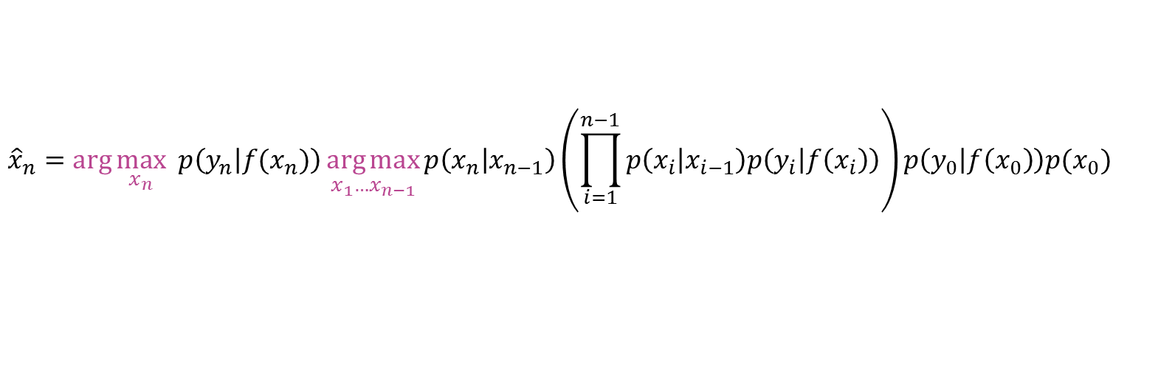
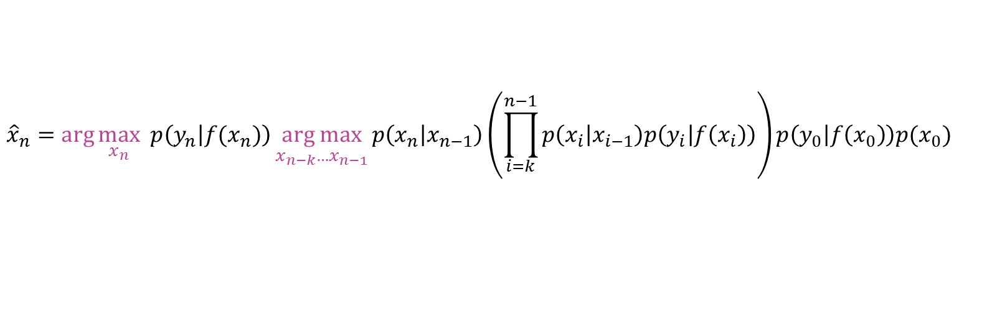
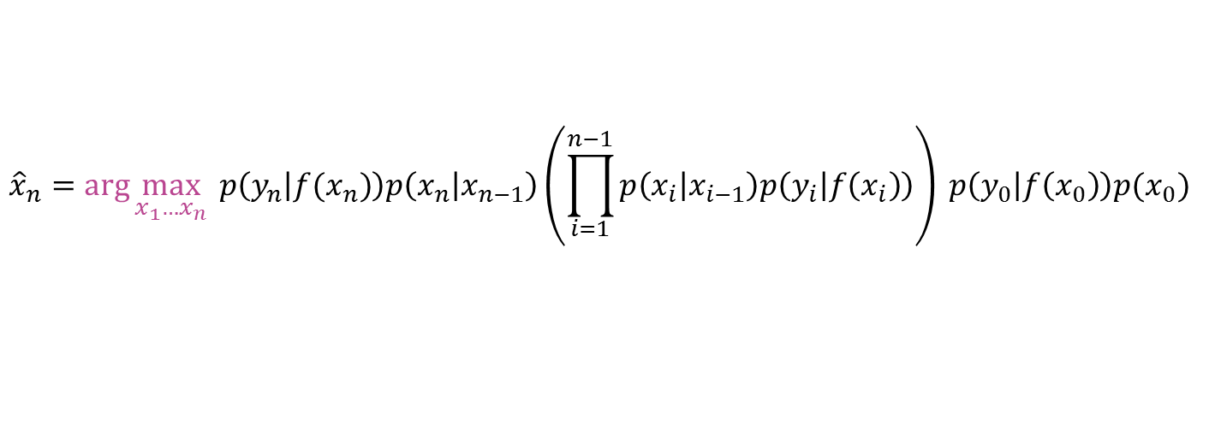
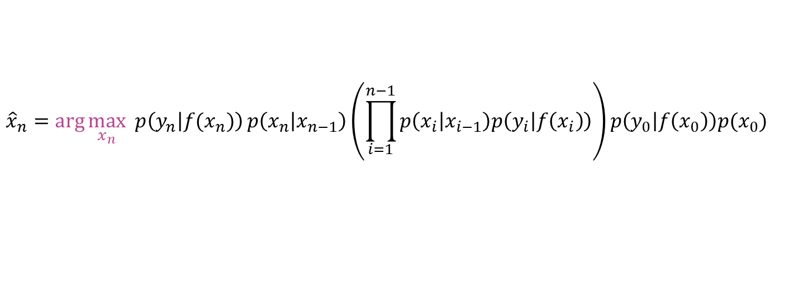

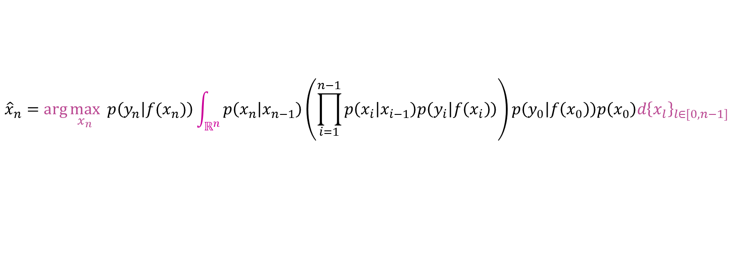
Maximization vs. Marginalization
Desired objective
$${\hat{x}}_{n}=\arg{\max_{x_{1}…x_{n}}{p\left(y_{n} | {f(x}_{n})\right)p\left(x_{n} | x_{n−1}\right)\left(\prod_{i=1}^{n−1}{p\left(x_{i} | x_{i−1}\right)p\left(y_{i} | f\left(x_{i}\right)\right)}\right)} p\left(y_{0} | f\left(x_{0}\right)\right)p(x_{0})}$$
Batch - maximization
$${\hat{x}}_{n}=\arg{\max_{x_{n}} p\left(y_{n} | {f(x}_{n})\right){\underset{x_{1}…x_{n−1}}{\arg{max}}{p\left(x_{n} | x_{n−1}\right)\left(\prod_{i=1}^{n−1}{p\left(x_{i} | x_{i−1}\right)p\left(y_{i} | f\left(x_{i}\right)\right)}\right)p\left(y_{0} | f\left(x_{0}\right)\right)p(x_{0})}} }$$
Naïve Online
$${\hat{x}}_{n}=\arg{\max_{x_{n}} p\left(y_{n} | {f(x}_{n})\right){p\left(x_{n} | x_{n−1}\right)\left(\prod_{i=1}^{n−1}{p\left(x_{i} | x_{i−1}\right)p\left(y_{i} | f\left(x_{i}\right)\right)}\right)p\left(y_{0} | f\left(x_{0}\right)\right)p(x_{0})} }$$
Online mini-batch
$${\hat{x}}_{n}=\arg{\max_{x_{n}} p\left(y_{n} | {f(x}_{n})\right){\underset{x_{n−k}…x_{n−1}}{arg max}{p\left(x_{n} | x_{n−1}\right)\left(\prod_{i=k}^{n−1}{p\left(x_{i} | x_{i−1}\right)p\left(y_{i} | f\left(x_{i}\right)\right)}\right)p\left(y_{0} | f\left(x_{0}\right)\right)p(x_{0})}} }$$
Batch - marginalization
$${\hat{x}}_{n}=\arg{\max_{x_{n}} p\left(y_{n} | {f(x}_{n})\right){\int_{ℝ^{n}}{p\left(x_{n} | x_{n−1}\right)\left(\prod_{i=1}^{n−1}{p\left(x_{i} | x_{i−1}\right)p\left(y_{i} | f\left(x_{i}\right)\right)}\right)p\left(y_{0} | f\left(x_{0}\right)\right)p\left(x_{0}\right)d{\left\{x_{l}\right\}}_{l∈[0,n−1]}}} }$$
Kalman
$${\hat{x}}_{n}=\arg{\max_{x_{n}}{ p\left(y_{n} | {f(x}_{n})\right) p\left(x_{n}\right)}}$$

Slide 18


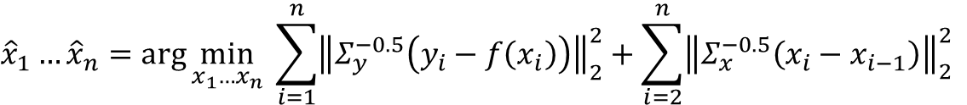
Plug in normal distributions in place of $p(⋅)$
Batch
$${\hat{x}}_{1}…{\hat{x}}_{n}=\arg{\min_{x_{1}…x_{n}}{\sum_{i=1}^{n}{{\left\|Σ_{y}^{−0.5}\left(y_{i}−f\left(x_{i}\right)\right)\right\|}_{2}^{2}}+\sum_{i=2}^{n}{{\left\|Σ_{x}^{−0.5}\left(x_{i}−x_{i−1}\right)\right\|}_{2}^{2}}}}$$
Naïve Online
$${\hat{x}}_{n}=\arg{\min_{x_{n}}{ {\left\|Σ_{y}^{−0.5}\left(y_{n}−f\left(x_{n}\right)\right)\right\|}_{2}^{2}}}+{\left\|Σ_{x}^{−0.5}\left(x_{n}−x_{n−1}\right)\right\|}_{2}^{2}$$
Online mini-batch
$${\hat{x}}_{n−k}…{\hat{x}}_{n}=\arg{\min_{x_{n−k}…x_{n}}{\sum_{i=n−k}^{n}{{\left\|Σ_{y}^{−0.5}\left(y_{i}−f\left(x_{i}\right)\right)\right\|}_{2}^{2}}+\sum_{i=n−k+1}^{n}{{\left\|Σ_{x}^{−0.5}\left(x_{i}−x_{i−1}\right)\right\|}_{2}^{2}}}}$$
Robust online mini-batch
$${\hat{x}}_{n−k}…{\hat{x}}_{n}=\arg{\min_{x_{n−k}…x_{n}}{\sum_{i=n−k}^{n}{{\left\|Σ_{y}^{−0.5}\left(y_{i}−f\left(x_{i}\right)\right)\right\|}_{2}^{2}}+\sum_{i=n−k+1}^{n}{{\left\|Σ_{x}^{−0.5}\left(x_{i}−x_{i−1}\right)\right\|}_{2}^{2}}}}+ρ\left(Σ_{x}^{−0.5}\left(x_{n−k}−x_{n−k−1}\right)\right)$$
$$ρ\left(r\right)=\frac{{\left(r/e\right)}^{2}}{1+{\left(r/e\right)}^{2}}$$
Kalman
$${\hat{x}}_{n}=\arg{\min_{x_{n}}{ {\left\|Σ_{y}^{−0.5}\left(y_{n}−f\left(x_{n}\right)\right)\right\|}_{2}^{2}}}+{\left\|{\left(P_{n−1}+Σ_{x}\right)}^{−0.5}\left(x_{n}−x_{n−1}\right)\right\|}_{2}^{2}$$
$P_{n}=P_{n−1}+Σ_{x}−K_{n}Φ_{n}\left(P_{n−1}+Σ_{x}\right)$

Slide 19

General Considerations
$$y=f\left(x\right)+ε$$
$$p\left(y | x\right)=\exp{{\left(y−f\left(x\right)\right)}^{T}Σ_{y}^{−1}(y−f(x))}$$
prior:
$$p\left(x\right)\sim 𝒩(0, ?)$$
posterior:
$$p\left(x | y\right)=\frac{p\left(y | x\right)p\left(x\right)}{p(y)}$$
$$p(x|y)=\exp{{\left(x−f^{−1}\left(y\right)\right)}^{T}Σ_{x}^{−1}\left(x−f^{−1}\left(y\right)\right)}$$
$$f^{−1}\left(y\right)≡\hat{x}=\arg{\max_{x}{p\left(y | x\right)}}$$
$$p\left(x | y\right)\sim 𝒩(\hat{x}, ?)$$

Slide 20
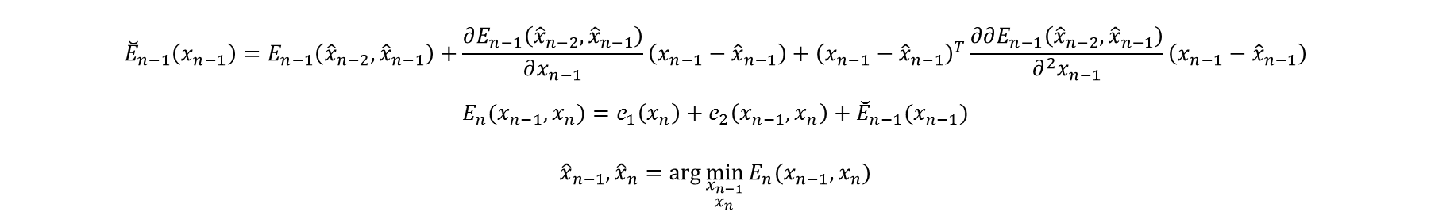

Batch of two, quadratic expansion
$$E_{1}(x_{1})=e_{1}\left(x_{1}\right)$$
$${\hat{x}}_{1}=\arg{\min_{x_{1}}{E_{1}\left(x_{1}\right)}}$$
$${\breve{E}}_{1}\left(x_{1}\right)=E_{1}(x_{1}) +\frac{∂E_{1}\left({\hat{x}}_{1}\right)}{∂x_{1}}\left(x_{1}−{\hat{x}}_{1}\right)+{\left(x_{1}−{\hat{x}}_{1}\right)}^{T}\frac{∂∂E_{1}\left({\hat{x}}_{1}\right)}{∂^{2}x_{1}}\left(x_{1}−{\hat{x}}_{1}\right)$$
$$E_{2}\left(x_{1}, x_{2}\right)=e_{1}\left(x_{2}\right)+e_{2}\left(x_{1}, x_{2}\right)+{\breve{E}}_{1}\left(x_{1}\right)$$
$$\frac{{∂E}_{2}\left(x_{1}, x_{2}\right)}{∂x_{2}}=\frac{∂e_{1}\left(x_{2}\right)}{∂x_{2}}+\frac{e_{2}\left(x_{1}, x_{2}\right)}{∂x_{2}}$$
$$…$$
$$E_{n−1}(x_{n−2}, x_{n−1})=e_{1}\left(x_{n−1}\right)+e_{2}\left(x_{n−1}, x_{n}\right)+{\breve{E}}_{n−2}(x_{n−2})$$
$${\hat{x}}_{n−2},{\hat{x}}_{n−1}=\arg{\min_{\begin{aligned}x_{n−2} \\ x_{n−1}\end{aligned}}{E_{n−1}(x_{n−2}, x_{n−1})}}$$
$${\breve{E}}_{n−1}\left(x_{n−1}\right)=E_{n−1}\left({\hat{x}}_{n−2},{\hat{x}}_{n−1}\right)+\frac{∂E_{n−1}\left({\hat{x}}_{n−2},{\hat{x}}_{n−1}\right)}{∂x_{n−1}}\left(x_{n−1}−{\hat{x}}_{n−1}\right)+{\left(x_{n−1}−{\hat{x}}_{n−1}\right)}^{T}\frac{∂∂E_{n−1}\left({\hat{x}}_{n−2},{\hat{x}}_{n−1}\right)}{∂^{2}x_{n−1}}\left(x_{n−1}−{\hat{x}}_{n−1}\right)$$
$$E_{n}(x_{n−1}, x_{n})=e_{1}\left(x_{n}\right)+e_{2}\left(x_{n−1}, x_{n}\right)+{\breve{E}}_{n−1}(x_{n−1})$$
$${\hat{x}}_{n−1},{\hat{x}}_{n}=\arg{\min_{\begin{aligned}x_{n−1} \\ x_{n}\end{aligned}}{E_{n}(x_{n−1}, x_{n})}}$$

Slide 21

Laplace Approximation to Posterior Distribution
$g\left(θ\right)=\log{f\left(y | θ\right)f\left(θ\right)}$
$f(y|θ)$ – likelihood of the data
$f(θ)$ – prior on the parameters
$θ^{∗}=\arg{\max_{θ}{g\left(θ\right)}}$
Second order Taylor series expansion about $θ=θ^{∗}$
$g\left(θ\right)≈g\left(θ^{∗}\right)+g_{θ}\left(θ^{∗}\right)\left(θ−θ^{∗}\right)−1/2{\left(θ−θ^{∗}\right)}^{T}g_{θθ}\left(θ^{∗}\right)\left(θ−θ^{∗}\right)$
Since $θ^{∗}$ is an extremum,
$g_{θ}\left(θ^{∗}\right)=0$
$g_{θθ}(θ^{∗})$ – positive definite
$exp⁡(g\left(θ\right))≈exp⁡(g\left(θ^{∗}\right)−1/2{\left(θ−θ^{∗}\right)}^{T}g_{θθ}\left(θ^{∗}\right)\left(θ−θ^{∗})\right)$
$exp⁡(\log{f\left(y | θ\right)f\left(θ\right)})≈exp⁡(\log{f\left(y | θ^{∗}\right)f\left(θ^{∗}\right)}−1/2{\left(θ−θ^{∗}\right)}^{T}g_{θθ}\left(θ^{∗}\right)\left(θ−θ^{∗})\right)$
$f\left(y | θ\right)f\left(θ\right)≈f\left(y | θ^{∗}\right)f\left(θ^{∗}\right)\exp\left(−\frac{1}{2}{\left(θ−θ^{∗}\right)}^{T}g_{θθ}\left(θ^{∗}\right)\left(θ−θ^{∗}\right)\right)$
$\frac{1}{{\left(2π\right)}^{N/2}{\left|g_{θθ}\left(θ^{∗}\right)\right|}^{\frac{1}{2}}}\exp\left(−\frac{1}{2}{\left(θ−θ^{∗}\right)}^{T}g_{θθ}\left(θ^{∗}\right)\left(θ−θ^{∗}\right)\right)≡𝒩\left(θ^{∗}, g_{θθ}{\left(θ^{∗}\right)}^{−1}\right)$
So, the posterior
$h\left(θ | Y\right)\sim 𝒩\left(θ^{∗}, g_{θθ}{\left(θ^{∗}\right)}^{−1}\right)$ and we already know $g_{θθ}\left(θ^{∗}\right)$ from the last step of optimization

Slide 22

Quadratic-two derivation
$$G\left(x_{n−1},x_{n}\right)={p\left(y_{n} | x_{n}\right)p\left(x_{n} | x_{n−1}\right)}p\left(x_{n−1}\right)$$
$$p\left(x_{n−1}\right)\sim p\left(y_{n−1} | x_{n−1}\right)p\left(x_{n−1} | x_{n−2}\right)…p\left(y_{1} | x_{1}\right)p(x_{1})$$
$$E\left(x_{n−1},x_{n}\right)=−\log{G\left(x_{n−1},x_{n}\right)=}{\left\|y_{n}−f\left(x_{n}\right)\right\|}_{2}^{2}+{\left\|x_{n}−x_{n−1}\right\|}_{2}^{2}+{\left\|\sqrt{Σ_{x_{n−1}, x_{n−1}}}\left(x_{n−1}−{\hat{x}}_{n−1}\right)\right\|}_{2}^{2}$$
$${\hat{x}}_{n−1}, {\hat{x}}_{n}=\arg{\max_{x_{n−1}, x_{n}}{E\left(x_{n−1},x_{n}\right)}}$$
Laplace approximation of posterior distribution $p(x_{n−1}, x_{n})$
$\breve{E}\left(x_{n−1},x_{n}\right)=E\left({\hat{x}}_{n−1},{\hat{x}}_{n}\right)+ \underset{=0}{\underbrace{dE\left({\hat{x}}_{n−1},{\hat{x}}_{n}\right)\left(\left[\begin{matrix}x_{n−1} \\ x_{n}\end{matrix}\right]−\left[\begin{matrix}{\hat{x}}_{n−1} \\ {\hat{x}}_{n}\end{matrix}\right]\right)}}+1/2{\left(\left[\begin{matrix}x_{n−1} \\ x_{n}\end{matrix}\right]−\left[\begin{matrix}{\hat{x}}_{n−1} \\ {\hat{x}}_{n}\end{matrix}\right]\right)}^{T}ddE\left({\hat{x}}_{n−1}, {\hat{x}}_{n}\right)\left(\left[\begin{matrix}x_{n−1} \\ x_{n}\end{matrix}\right]−\left[\begin{matrix}{\hat{x}}_{n−1} \\ {\hat{x}}_{n}\end{matrix}\right]\right)$
$K={\left(2π\sqrt{\det{ddE\left({\hat{x}}_{n−1}, {\hat{x}}_{n}\right)}}\right)}^{−1}$
$\breve{p}\left(x_{n−1}, x_{n}\right)=exp\left(−\breve{E}\left(x_{n−1},x_{n}\right)\right)=\exp\left(−E\left({\hat{x}}_{n−1},{\hat{x}}_{n}\right)\right)\frac{1}{K}\underset{𝒩 }{\underbrace{K exp\left(−1/2{\left(\left[\begin{matrix}x_{n−1} \\ x_{n}\end{matrix}\right]−\left[\begin{matrix}{\hat{x}}_{n−1} \\ {\hat{x}}_{n}\end{matrix}\right]\right)}^{T}ddE\left({\hat{x}}_{n−1}, {\hat{x}}_{n}\right)\left(\left[\begin{matrix}x_{n−1} \\ x_{n}\end{matrix}\right]−\left[\begin{matrix}{\hat{x}}_{n−1} \\ {\hat{x}}_{n}\end{matrix}\right]\right)\right)}}$
$$\breve{p}\left(x_{n−1}, x_{n}\right) \sim \underset{L}{\underbrace{\exp\left(−E\left({\hat{x}}_{n−1},{\hat{x}}_{n}\right)\right)\frac{1}{K}}}𝒩\left(\left[\begin{matrix}{\hat{x}}_{n−1} \\ {\hat{x}}_{n}\end{matrix}\right], {\left(ddE\left({\hat{x}}_{n−1}, {\hat{x}}_{n}\right)\right)}^{−1} \right)$$
Laplace approximation of marginal posterior distribution $p(x_{n})$
$\breve{p}(x_{n})$ $\sim L\int{\breve{p}\left(x_{n−1}, x_{n}\right)dx_{n−1}}\sim L𝒩\left({\hat{x}}_{n},Σ_{x_{n}, x_{n}}\right)$
$Σ_{x_{n}, x_{n}}={\left(ddE{\left({\hat{x}}_{n−1}, {\hat{x}}_{n}\right)}^{−1}\right)}_{22}$
$$ddE\left({\hat{x}}_{n−1}, {\hat{x}}_{n}\right)=\left[\begin{matrix}A & B \\ C & D\end{matrix}\right]$$
$${\left(ddE\left({\hat{x}}_{n−1}, {\hat{x}}_{n}\right)\right)}^{−1}=\left[\begin{matrix}{\left(A −BD^{−1}C\right)}^{−1} & {−\left(A −BD^{−1}C\right)}^{−1}BD^{−1} \\ −{\left(D−CA^{−1}B\right)}^{−1}CA^{−1} & {\left(D−CA^{−1}B\right)}^{−1}\end{matrix}\right]$$
${\left(ddE{\left({\hat{x}}_{n−1}, {\hat{x}}_{n}\right)}^{−1}\right)}_{22}≡Σ_{x_{n}, x_{n}}={\left(D−CA^{−1}B\right)}^{−1}$
$$G\left(x_{n},x_{n+1}\right)={p\left(y_{n+1} | x_{n+1}\right)p\left(x_{n+1} | x_{n}\right)}\breve{p}\left(x_{n}\right)$$
$$E\left(x_{n},x_{n+1}\right)=−\log{G\left(x_{n},x_{n}\right)=}{\left\|y_{n+1}−f\left(x_{n+1}\right)\right\|}_{2}^{2}+{\left\|x_{n+1}−x_{n}\right\|}_{2}^{2}+{\left\|\sqrt{Σ_{x_{n}, x_{n}}}\left(x_{n}−{\hat{x}}_{n}\right)\right\|}_{2}^{2}−\overset{=const}{\overbrace{log⁡(L)}}$$

Slide 23



Maximization vs. Marginalization
Laplace approximation
$Σ^{−1}≈H≡\left[\begin{matrix}a & b \\ c & d\end{matrix}\right]$
$Σ≡\left[\begin{matrix}Σ_{11} & Σ_{12} \\ Σ_{21} & Σ_{22}\end{matrix}\right]≈\left[\begin{matrix}{\left(a −bd^{−1}c\right)}^{−1} & {−\left(a −bd^{−1}c\right)}^{−1}bd^{−1} \\ −{\left(d−ca^{−1}b\right)}^{−1}ca^{−1} & {\left(d−ca^{−1}b\right)}^{−1}\end{matrix}\right]$
Laplace approximation of joint distribution
$p\left(x_{n−1},x_{n}\right)\sim 𝒩\left(\left[\begin{matrix}{\hat{x}}_{n−1} \\ {\hat{x}}_{n}\end{matrix}\right], Σ\right)$
Laplace approximation of marginal distribution
$p\left(x_{n}\right)\sim 𝒩\left({\hat{x}}_{n}, Σ_{22}\right)≈𝒩\left({\hat{x}}_{n},{\left(d−ca^{−1}b\right)}^{−1}\right)$
? This posterior is obtained by marginalizing $x_{n−1}$
Laplace approximation of conditional distribution
$p\left(x_{n} | x_{n−1}={\hat{x}}_{n−1}\right)\sim 𝒩\left({\hat{x}}_{n},{Σ_{22}− Σ}_{12}^{T}Σ_{11}^{−1}Σ_{12}\right)≈𝒩\left({\hat{x}}_{n},d^{−1}\right)$
? This posterior is obtained by maximizing $x_{n−1}$, since we use $x_{n−1}={\hat{x}}_{n−1}$
Joint Distribution
$p\left(x_{n−1},x_{n}\right)\sim 𝒩\left(\left[\begin{matrix}{\hat{x}}_{n−1} \\ {\hat{x}}_{n}\end{matrix}\right], Σ\right)$
Marginal distribution
$p\left(x_{n}\right)= \int{p\left(x_{n−1}, x_{n}\right)dx_{n−1}}\sim 𝒩\left({\hat{x}}_{n}, Σ_{22}\right)$
Conditional distribution
$p\left(x_{n} | x_{n−1}={\hat{x}}_{n−1}\right)=\frac{p\left(x_{n−1}, x_{n}\right)}{p(x_{n−1})}\sim 𝒩\left({\hat{x}}_{n}, {Σ_{22}− Σ}_{12}^{T}Σ_{11}^{−1}Σ_{12}\right)$

Slide 24



Kalman filter vs Quadratic-two
$$g\left(x_{1}, …x_{n}\right)=p\left(y_{n} | x_{n}\right)p\left(x_{n} | x_{n−1}\right)…p\left(y_{2} | x_{2}\right)p\left(x_{2} | x_{1}\right)p\left(y_{1} | x_{1}\right)p(x_{1})$$
Kalman Filter
$g\left(x_{1},…x_{n}\right)=p(y_{n}|x_{n})\breve{p}\left(x_{n}\right)$
$\breve{p}(x_{n})\sim 𝒩({\hat{x}}_{n−1}, H^{−1})$
Quadratic-two
$$g\left(x_{1},…{x_{n−1},x}_{n}\right)={p\left(y_{n} | x_{n}\right)p\left(x_{n} | x_{n−1}\right)}\breve{p}\left(x_{n−1}\right)$$
$\breve{p}(x_{n−1})$ $\sim \int{\breve{p}\left(x_{n−2}, x_{n−1}\right)dx_{n−2}}\sim 𝒩{\left({\hat{x}}_{n−1},{(H}^{−1}\right)}_{22})$
$$F\left(x_{n−1},x_{n}\right)=\left[\begin{matrix}\begin{aligned}F_{1}(x_{n}) \\ {\sqrt{ω_{2}}(x}_{n}−x_{n−1})\end{aligned} \\ \sqrt{\frac{∂^{2}E({\hat{x}}_{n−2}, {\hat{x}}_{n−1})}{∂^{2}x_{n}}}\left(x_{n−1}−{\hat{x}}_{n−1}\right)\end{matrix}\right]$$
$$F\left(x_{n}\right)=\left[\begin{matrix}F_{1}(x_{n}) \\ \sqrt{\frac{∂^{2}E({\hat{x}}_{n}) }{∂^{2}x_{n}}}\left(x_{n}−{\hat{x}}_{n−1}\right)\end{matrix}\right]$$
$$\frac{∂^{2}E({\hat{x}}_{n}) }{∂^{2}x_{n}}=\frac{∂^{2}H_{1}\left({\hat{x}}_{n}\right)}{∂^{2}x_{n}}+\frac{∂^{2}E({\hat{x}}_{n−1}) }{∂^{2}x_{n−1}}$$
$$\frac{∂^{2}E({\hat{x}}_{n−1}, {\hat{x}}_{n})}{∂^{2}x_{n}}≈\left(\frac{∂^{2}H_{1}\left({\hat{x}}_{n−1}, {\hat{x}}_{n}\right)}{∂^{2}x_{n}}+2ω_{2}I\right)−4ω_{2}^{2}{\left(\frac{∂^{2}E({\hat{x}}_{n−2, }{\hat{x}}_{n−1})}{∂^{2}x_{n−1}}+2ω_{2}I\right)}^{−1}$$

Slide 25


Quadratic one - Eliminating $x_{n−1}$
$${\hat{x}}_{n−1}, {\hat{x}}_{n}=\arg{\min_{x_{n−1}, x_{n}}{{\left\|y_{n}−f\left(x_{n}\right)\right\|}_{2}^{2}+ω_{2}{\left\|x_{n}−x_{n−1}\right\|}_{2}^{2}+{\left\|\sqrt{Σ_{x_{n−1}, x_{n−1}}}\left(x_{n−1}−{\hat{x}}_{n−1}\right)\right\|}_{2}^{2}}}$$
$${\hat{x}}_{n−1}, {\hat{x}}_{n}=\arg{\min_{ x_{n}}{{\left\|y_{n}−f\left(x_{n}\right)\right\|}_{2}^{2}+\arg{\min_{x_{n−1}}{ω_{2}{\left\|x_{n}−x_{n−1}\right\|}_{2}^{2}+{\left\|\sqrt{Σ_{x_{n−1}, x_{n−1}}}\left(x_{n−1}−{\hat{x}}_{n−1}\right)\right\|}_{2}^{2}}}}}$$
$$\left(∗\right)=ω_{2}{\left\|x_{n}−x_{n−1}\right\|}_{2}^{2}+{\left\|\sqrt{Σ_{x_{n−1}, x_{n−1}}}\left(x_{n−1}−{\hat{x}}_{n−1}\right)\right\|}_{2}^{2}=ω_{2}{\left(x_{n}−x_{n−1}\right)}^{T}\left(x_{n}−x_{n−1}\right)+{\left(x_{n−1}−{\hat{x}}_{n−1}\right)}^{T}Σ_{x_{n−1}, x_{n−1}}\left(x_{n−1}−{\hat{x}}_{n−1}\right)$$
$$Ω_{2}=ω_{2}∗I_{M×M}$$
$$Ω_{3}=Σ_{x_{n−1}, x_{n−1}}$$
$$e={\hat{x}}_{n−1}^{T}Ω_{3}{\hat{x}}_{n−1}+x_{n}^{T}Ω_{2}x_{n}+f_{1}(x_{n})$$
$$E_{2,3}=x_{n−1}^{T}\left(Ω_{2}+Ω_{3}\right)x_{n−1}−2x_{n−1}^{T}\left(Ω_{2}x_{n}+Ω_{3}{\hat{x}}_{n−1}\right)+e$$
$$\frac{∂E_{2,3}}{∂x_{n−1}}=2\left(Ω_{2}+Ω_{3}\right)x_{n−1}−2\left(Ω_{2}x_{n}+Ω_{3}{\hat{x}}_{n−1}\right)$$
$$x_{n−1}^{∗}=\arg{\min_{x_{n−1}}{\frac{∂E_{2,3}}{∂x_{n−1}}}}={\left(Ω_{2}+Ω_{3}\right)}^{−1}\left(Ω_{2}x_{n}+Ω_{3}{\hat{x}}_{n−1}\right)$$
$$M={\left(Ω_{2}+Ω_{3}\right)}^{−1}Ω_{2}$$
$$m={\left(Ω_{2}+Ω_{3}\right)}^{−1}Ω_{3}{\hat{x}}_{n−1}$$
$$x_{n−1}^{∗}=Mx_{n}+m$$
$$\left(∗∗\right)={\left\|y_{n}−f\left(x_{n}\right)\right\|}_{2}^{2}+{\left\|{\sqrt{Ω_{2}}(x}_{n}−x_{n−1})\right\|}_{2}^{2}+{\left\|\sqrt{Ω_{3}}\left(x_{n−1}−{\hat{x}}_{n−1}\right)\right\|}_{2}^{2}$$
$$\left(∗∗\right)={\left\|y_{n}−f\left(x_{n}\right)\right\|}_{2}^{2}+{\left\|{\sqrt{Ω_{2}}(x}_{n}−Mx_{n}+m)\right\|}_{2}^{2}+{\left\|\sqrt{Ω_{3}}\left(Mx_{n}+m−{\hat{x}}_{n−1}\right)\right\|}_{2}^{2}$$
$A=\sqrt{Ω_{2}}\left(I −M\right), b= \sqrt{Ω_{2}}m$, $C=\sqrt{Ω_{3}}M, d=\sqrt{Ω_{3}}(m − {\hat{x}}_{n−1})$
$$L={\left(A^{T}A+C^{T}C\right)}^{1/2}, l={\left(A^{T}A+C^{T}C\right)}^{−\frac{1}{2}}(Ab+Cd)$$
$$\left(∗∗\right)={\left\|y_{n}−f\left(x_{n}\right)\right\|}_{2}^{2}+{\left\|{Lx}_{n}+l\right\|}_{2}^{2}$$
$${\hat{x}}_{n−1}≡x_{n−1}^{∗}(x_{n}), {\hat{x}}_{n}=\arg{\min_{ x_{n}}{{\left\|y_{n}−f\left(x_{n}\right)\right\|}_{2}^{2}+}}{\left\|{Lx}_{n}+l\right\|}_{2}^{2}$$

Slide 26

$$f_{1}(x_{n})={\left\|y_{n}−f\left(x_{n}\right)\right\|}_{2}^{2}$$
$${\tilde{x}}_{n}=\arg{\max_{x_{n}}{f_{1}\left(x_{n}\right)}}$$
Batch online 2
$${\left\|{\hat{x}}_{n−2}−x_{n−1}\right\|}_{2}^{2}+{\left\|{\left(h_{1}\left({\tilde{x}}_{n−1}\right)\right)}^{0.5}\left(x_{n−1}−{\tilde{x}}_{n−1}\right)\right\|}_{2}^{2}+{\left\|x_{n}−x_{n−1}\right\|}_{2}^{2}+{\left\|{\left(h_{1}\left({\tilde{x}}_{n}\right)\right)}^{0.5}\left(x_{n}−{\tilde{x}}_{n}\right)\right\|}_{2}^{2}$$
Batch independent
$${{\left\|{\left(h_{1}\left({\tilde{x}}_{n−1}\right)\right)}^{0.5}\left(x_{n−1}−{\tilde{x}}_{n−1}\right)\right\|}_{2}^{2}+{\left\|x_{n}−x_{n−1}\right\|}_{2}^{2}+\left\|{\left(h_{1}\left({\tilde{x}}_{n}\right)\right)}^{0.5}\left(x_{n}−{\tilde{x}}_{n}\right)\right\|}_{2}^{2}$$
Quadratic-one
$${{\left\|{\left(h_{1}({\hat{x}}_{n−1})+h_{2}({\hat{x}}_{n−1})+h_{3}({\hat{x}}_{n−1})\right)}^{−0.5}\left(x_{n−1}−{\hat{x}}_{n−1}\right)\right\|}_{2}^{2}+{\left\|x_{n}−x_{n−1}\right\|}_{2}^{2}+\left\|{\left(h_{1}\left({\tilde{x}}_{n}\right)\right)}^{0.5}\left(x_{n}−{\tilde{x}}_{n}\right)\right\|}_{2}^{2}$$
Kalman
$${{\left\|{(h_{1}({\hat{x}}_{n−1})+h_{2}({\hat{x}}_{n−1}))}^{−0.5}\left({\hat{x}}_{n−1}−x_{n}\right)\right\|}_{2}^{2}+\left\|{\left(h_{1}\left({\tilde{x}}_{n}\right)\right)}^{0.5}\left(x_{n}−{\tilde{x}}_{n}\right)\right\|}_{2}^{2}$$
If the next frame is strictly less certain, it will hold the value, otherwise, weird things may happen
Holding to the previous value with constant radius is probably causing the problems. Try to replace this with probabilistic holding
Think if this can explain the behavior of batch 5 or 15. Try to simulate it
Try alternating optimization to verify the simulation. Compare the results.

Slide 27



Kalman Filter – Probabilistic Interpretation
$${{\left\|{\left(h\left({\hat{x}}_{n−1}\right)\right)}^{−0.5}\left({\hat{x}}_{n−1}−x_{n}\right)\right\|}_{2}^{2}+\left\|{\left(h_{1}\left({\tilde{x}}_{n}\right)\right)}^{0.5}\left(x_{n}−{\tilde{x}}_{n}\right)\right\|}_{2}^{2}$$
$$F\left(x_{n}\right)=\left[\begin{matrix}F_{1}(x_{n}) \\ \sqrt{H\left({\hat{x}}_{n−1}\right)}\left(x_{n}−{\hat{x}}_{n−1}\right)\end{matrix}\right]$$
$$h\left({\hat{x}}_{n−1}\right)=\sum_{i}^{n−1}{h_{1}({\hat{x}}_{i})}$$
$${\left({\hat{x}}_{n−1}−x_{n}\right)}^{T}\sum_{i}^{n−1}{h_{1}({\hat{x}}_{i})}\left({\hat{x}}_{n−1}−x_{n}\right)+{\left(x_{n}−{\tilde{x}}_{n}\right)}^{T}h_{1}\left({\tilde{x}}_{n}\right)\left(x_{n}−{\tilde{x}}_{n}\right)$$
the objective function is a product of $n−1$ distributions with $Σ$ given by each independent frame and $μ={\hat{x}}_{n−1}$ and the independent distribution at the frame $n$

Slide 28


Quadratic-one – Probabilistic Interpretation
$${\left({\hat{x}}_{n−1}−x_{n}\right)}^{T}h\left({\hat{x}}_{n−1}\right)\left({\hat{x}}_{n−1}−x_{n}\right)+{\left(x_{n}−x_{n−1}\right)}^{T}\left(x_{n}−x_{n−1}\right)+{\left(x_{n}−{\tilde{x}}_{n}\right)}^{T}h_{1}\left({\tilde{x}}_{n}\right)\left(x_{n}−{\tilde{x}}_{n}\right)$$
$$h\left({\hat{x}}_{n−1}\right)=h_{1}\left({\hat{x}}_{n−1}\right)+h_{2}\left({\hat{x}}_{n−1}\right)+h_{3}\left({\hat{x}}_{n−1}\right)$$
$$F\left(x_{n−1},x_{n}\right)=\left[\begin{matrix}\begin{aligned}F_{1}(x_{n}) \\ x_{n}−x_{n−1}\end{aligned} \\ \sqrt{H({\hat{x}}_{n−2}, {\hat{x}}_{n−1})}\left(x_{n−1}−{\hat{x}}_{n−1}\right)\end{matrix}\right]$$
$$h_{3}\left({\hat{x}}_{n−1}\right)=h_{1}\left({\hat{x}}_{n−2}\right)+h_{2}\left({\hat{x}}_{n−2}\right)+h_{3}\left({\hat{x}}_{n−2}\right)$$
$$h\left({\hat{x}}_{n−1}\right)=\sum_{i}^{n−1}{\left(h_{1}\left({\hat{x}}_{i}\right)+h_{2}\left({\hat{x}}_{i}\right)\right)}$$
$${\left\|{\hat{x}}_{n−2}−x_{n−1}\right\|}_{2}^{2}+{\left\|{\left(h_{1}\left({\tilde{x}}_{n−1}\right)\right)}^{0.5}\left(x_{n−1}−{\tilde{x}}_{n−1}\right)\right\|}_{2}^{2}+{\left\|x_{n}−x_{n−1}\right\|}_{2}^{2}+{\left\|{\left(h_{1}\left({\tilde{x}}_{n}\right)\right)}^{0.5}\left(x_{n}−{\tilde{x}}_{n}\right)\right\|}_{2}^{2}$$

Slide 29



Independent “Laplace Approximation”
${\tilde{x}}_{n}=\arg{\max_{x_{n}}{f_{1}\left(x_{n}\right)}}$
$h_{1}(x_{n})=\frac{∂∂f_{1}\left(x_{n}\right)}{∂x_{n}∂x_{n}}$
Posterior distribution
$𝒩\left(x_{n} | {\tilde{x}}_{n}, h_{1}({\tilde{x}}_{n})\right)$
Current Optimizations
Batch online two
$$𝒩\left(x_{n−1} | {\hat{x}}_{n−2},I\right)×𝒩\left(x_{n−1} | {\tilde{x}}_{n−1},h_{1}\left({\tilde{x}}_{n−1}\right)\right)×𝒩\left(x_{n} | x_{n−1},I\right)×𝒩\left(x_{n} | {\tilde{x}}_{n},h_{1}\left({\tilde{x}}_{n}\right)\right)$$
Batch independent
$$𝒩\left(x_{n−1} | {\tilde{x}}_{n−1},h_{1}\left({\tilde{x}}_{n−1}\right)\right)×𝒩\left(x_{n} | x_{n−1},I\right)×𝒩\left(x_{n} | {\tilde{x}}_{n},h_{1}\left({\tilde{x}}_{n}\right)\right)$$
Quadratic-two maximization
$$𝒩\left(x_{n−1} | {\hat{x}}_{n−1},I\right)×𝒩\left(x_{n−1} | {\hat{x}}_{n−1},h_{1}\left({\hat{x}}_{n−1}\right)\right)×𝒩\left(x_{n} | x_{n−1},I\right)×𝒩\left(x_{n} | {\tilde{x}}_{n},h_{1}\left({\tilde{x}}_{n}\right)\right)$$
Kalman
$$𝒩\left(x_{n} | {\hat{x}}_{n−1},\sum_{i}^{n−1}{h_{1}\left({\hat{x}}_{i}\right)}\right)×𝒩\left(x_{n} | {\tilde{x}}_{n},h_{1}\left({\tilde{x}}_{n}\right)\right)$$
$$\prod_{i}{𝒩\left(x_{n} | {\hat{x}}_{n−1},h_{1}\left({\hat{x}}_{i}\right)\right)}×𝒩\left(x_{n} | {\tilde{x}}_{n},h_{1}\left({\tilde{x}}_{n}\right)\right)$$
Alternatives
Kalman-two
$$𝒩\left(x_{n−1} | {\hat{x}}_{n−1},\sum_{i}^{n−1}{h_{1}\left({\hat{x}}_{i}\right)}\right)×𝒩\left(x_{n} | x_{n−1},I\right)×𝒩\left(x_{n} | {\tilde{x}}_{n},h_{1}\left({\tilde{x}}_{n}\right)\right)$$
?
$$𝒩\left(x_{i−1} | {\hat{x}}_{i−1},I\right)\prod_{i}{𝒩\left(x_{i} | {\hat{x}}_{n−1},h_{1}\left({\hat{x}}_{i}\right)\right)}×𝒩\left(x_{n} | {\tilde{x}}_{n},h_{1}\left({\tilde{x}}_{n}\right)\right)$$
$$𝒩\left(x_{i−1} | {\hat{x}}_{i−1},I\right)\prod_{i}{𝒩\left(x_{i} | {\hat{x}}_{n−1},h_{1}\left(x_{i}\right)\right)}×𝒩\left(x_{n} | {\tilde{x}}_{n},h_{1}\left({\tilde{x}}_{n}\right)\right)$$

Slide 30

$$g\left(x_{1}, x_{2}\right)=p\left(y_{2} | x_{2}\right)p\left(x_{2} | x_{1}\right)p\left(y_{1} | x_{1}\right)p\left(x_{1}\right)=p\left(y_{2} | x_{2}\right)p\left(y_{1} | x_{1}\right)p(x_{1}, x_{2})$$
$$E\left(x_{1},x_{2}\right)=−\log{g\left(x_{1},x_{2}\right)=}{\left\|y_{2}−f\left(x_{2}\right)\right\|}_{2}^{2}+{\left\|x_{2}−x_{1}\right\|}_{2}^{2}+{\left\|y_{1}−f\left(x_{1}\right)\right\|}_{2}^{2}$$
$${\hat{x}}_{1}, {\hat{x}}_{2}=\arg{\max_{x_{1}, x_{2}}{E\left(x_{1},x_{2}\right)}}$$
…
Laplace approximation of posterior distribution
$$H\left(x_{n−2} x_{n−1}\right) \sim 𝒩\left(\left[\begin{matrix}{\hat{x}}_{n−2} \\ {\hat{x}}_{n−1}\end{matrix}\right], {\left(ddE\left({\hat{x}}_{n−2}, {\hat{x}}_{n−1}\right)\right)}^{−1} \right)$$
where
$$ddE\left({\hat{x}}_{n−2}, {\hat{x}}_{n−1}\right)=\left[\begin{matrix}\frac{∂∂E\left({\hat{x}}_{n−2}, {\hat{x}}_{n−1}\right)}{∂^{2}x_{n−2}} & \frac{∂∂E\left({\hat{x}}_{n−2}, {\hat{x}}_{n−1}\right)}{∂x_{n−2}∂x_{n−1}} \\ \frac{∂∂E\left({\hat{x}}_{n−2}, {\hat{x}}_{n−1}\right)}{∂x_{n−2}∂x_{n−1}} & \frac{∂∂E\left({\hat{x}}_{n−2}, {\hat{x}}_{n−1}\right)}{∂^{2}x_{n−1}}\end{matrix}\right]=\left[\begin{matrix}A & B \\ C & D\end{matrix}\right]=\left[\begin{matrix}\begin{matrix}A_{ββ} & A_{βθ} \\ A_{βθ} & A_{ββ}\end{matrix} & \begin{matrix}B_{ββ} & B_{βθ} \\ B_{βθ} & B_{ββ}\end{matrix} \\ \begin{matrix}C_{ββ} & C_{βθ} \\ C_{βθ} & C_{ββ}\end{matrix} & \begin{matrix}D_{ββ} & D_{βθ} \\ D_{βθ} & D_{ββ}\end{matrix}\end{matrix}\right]$$
$${\left(ddE\left({\hat{x}}_{n−2}, {\hat{x}}_{n−1}\right)\right)}^{−1}=\left[\begin{matrix}{\left(A −BD^{−1}C\right)}^{−1} & {−\left(A −BD^{−1}C\right)}^{−1}BD^{−1} \\ −{\left(D−CA^{−1}B\right)}^{−1}CA^{−1} & {\left(D−CA^{−1}B\right)}^{−1}\end{matrix}\right]$$
Laplace approximation of marginal posterior distribution $\breve{p}(x_{n−1})$ $\sim 𝒩({\hat{x}}_{n−1},Σ_{22}={\left(D−CA^{−1}B\right)}^{−1})$
$$\breve{p}\left(x_{n−1}\right)\sim p\left(y_{n−1} | x_{n−1}\right)p\left(x_{n−1} | x_{n−2}\right)…p\left(y_{2} | x_{2}\right)p\left(x_{2} | x_{1}\right)p\left(y_{1} | x_{1}\right)p(x_{1})$$
$$g\left(x_{1},…x_{n}\right)={p\left(y_{n} | x_{n}\right)p\left(x_{n} | x_{n−1}\right)}\breve{p}\left(x_{n−1}\right)$$
$\breve{p}(x_{n−1})$ $\sim \int{\breve{p}\left(x_{n−2}, x_{n−1}\right)dx_{n−2}}\sim 𝒩{\left({\hat{x}}_{n−1},{(H}^{−1}\right)}_{22})$
$$E\left(x_{n−1},x_{n}\right)={\left\|y_{n}−f\left(x_{n}\right)\right\|}_{2}^{2}+{\left\|x_{n}−x_{n−1}\right\|}_{2}^{2}+{\left\|\sqrt{Σ_{22}}\left(x_{n−1}−{\hat{x}}_{n−1}\right)\right\|}_{2}^{2}$$

Slide 31


Kalman Filter vs Quadratic one
$$Ω_{2}=ω_{2}∗I_{M×M}$$
$$Ω_{3}=H_{{\hat{x}}_{n−1}, {\hat{x}}_{n−1}}$$
$$M={\left(Ω_{2}+Ω_{3}\right)}^{−1}Ω_{2}$$
$$m={\left(Ω_{2}+Ω_{3}\right)}^{−1}Ω_{3}{\hat{x}}_{n−1}$$
$A=\sqrt{Ω_{2}}\left(I −M\right)$
$b= \sqrt{Ω_{2}}m$
$C=\sqrt{Ω_{3}}M$
$d=\sqrt{Ω_{3}}(m − {\hat{x}}_{n−1})$
$$L={\left(A^{T}A+C^{T}C\right)}^{1/2}$$
$$l={\left(A^{T}A+C^{T}C\right)}^{−\frac{1}{2}}(Ab+Cd)$$
$${\hat{x}}_{n}=\arg{\min_{ x_{n}}{{\left\|y_{n}−f\left(x_{n}\right)\right\|}_{2}^{2}+}}{\left\|{Lx}_{n}+l\right\|}_{2}^{2}$$
$$H=ω_{2}I−ω_{2}^{2}inv\left(ω_{2}I+Ω_{3}\right)=ω_{2}I−ω_{2}^{2}inv\left(Ω_{3}\right)−ω_{2}inv\left(Ω_{3}\right)inv\left(Ω_{3}\right)$$
$${\hat{x}}_{n}=\arg{\min_{ x_{n}}{{\left\|y_{n}−f\left(x_{n}\right)\right\|}_{2}^{2}+}}{\left\|{{\left(H_{{\hat{x}}_{n−1}, {\hat{x}}_{n−1}}\right)}^{1/2} (x}_{n}−{\hat{x}}_{n−1})\right\|}_{2}^{2}$$
$${\left(x_{n}−{\hat{x}}_{n−1}\right)}^{T}H_{{\hat{x}}_{n−1}, {\hat{x}}_{n−1}}\left(x_{n}−{\hat{x}}_{n−1}\right)$$

Slide 32







Notation by Dr. Fitzgibbon
“Solve”
“Simulate”
Optimizing a frame independently
$$f_{1}\left(x_{n}\right)=F_{1}{\left(x_{n}\right)}^{T}F_{1}\left(x_{n}\right)$$
${\tilde{x}}_{n}=\arg{\max_{x_{n}}{f_{1}{\left(x_{n}\right)}^{T}}}$
$$h_{1}({\tilde{x}}_{n})=\frac{∂∂f_{1}\left({\tilde{x}}_{n}\right)}{∂x_{n}∂x_{n}}$$
Optimizing a sequence with Kalman-like algorithm
$$F_{n}\left(x_{n}\right)=\left[\begin{matrix}F_{n1}(x_{n}) \\ {\left(\sum_{i}^{n−1}{h_{i1}\left({\hat{x}}_{i}\right)}\right)}^{1/2}\left(x_{n}−{\hat{x}}_{n−1}\right)\end{matrix}\right]$$
$$F_{n}\left(x_{n}\right)=\left[\begin{matrix}{\left(h_{1}\left({\tilde{x}}_{n}\right)\right)}^{1/2} \left(x_{n}−{\tilde{x}}_{n}\right) \\ {\left(h_{n−1}\right)}^{1/2}\left(x_{n}−{\hat{x}}_{n−1}\right)\end{matrix}\right]$$
$${\hat{x}}_{n}=\arg{\max_{x_{n}}{f_{n}\left(x_{n}\right)}}$$
$$h_{n1}=J_{n1}{\left({\hat{x}}_{n}\right)}^{T}J_{n1}\left({\hat{x}}_{n}\right)$$
$$h_{n}\left({\hat{x}}_{n}\right)=h_{n1}+\sum_{i}^{n−1}{h_{i1}\left({\hat{x}}_{i}\right)}$$
$$h_{n}=h_{1}\left({\tilde{x}}_{n}\right)+h_{n−1}$$

Slide 33



Extended Information Filter
measurement update
$${inv(P}_{k})={inv(P}_{k}^{−})+H_{k}^{T}inv(R_{k})H_{k}$$
$$K_{k}=P_{k}H_{k}^{T}inv(R_{k})$$
$${\hat{x}}_{k}={\hat{x}}_{k}^{−}+K_{k}(z_{k}−h({\hat{x}}_{k}^{−}))$$
time update
$${\hat{x}}_{k+1}^{−}={\hat{x}}_{k}$$
$$P_{k+1}^{−}=P_{k}+Q_{k}$$
Extended Information Filter my notation I
measurement update
$${\hat{H}}_{k}={\hat{H}}_{k}^{−}+{\frac{1}{r}J}_{k}^{T}J_{k}$$
$${\hat{x}}_{k}={\hat{x}}_{k}^{−}+\frac{1}{r}{\left({\hat{H}}_{k}\right)}^{−1}J_{k}^{T}(z_{k}−f({\hat{x}}_{k}^{−}))$$
time update
$${\hat{x}}_{k+1}^{−}={\hat{x}}_{k}$$
$${\left({\hat{H}}_{k+1}^{−}\right)}^{−1}={\left({\hat{H}}_{k}\right)}^{−1}+Q_{k}$$
Extended Information Filter my notation II
$${\hat{H}}_{n}={\hat{H}}_{n−1}+{\frac{1}{r}J}_{n}^{T}J_{n}$$
$${\hat{x}}_{n}={\hat{x}}_{n−1}+\frac{1}{r}{\left({\hat{H}}_{n}\right)}^{−1}J_{n}^{T}(y_{n}−f({\hat{x}}_{n−1}))$$
$${\left({\hat{H}}_{n}\right)}^{−1}={\left({\hat{H}}_{n}\right)}^{−1}+Q$$

Slide 34









Extended Information Filter
$${\hat{H}}_{n}={\hat{H}}_{n−1}+{\frac{1}{r}J}_{n}^{T}J_{n}$$
$${\hat{x}}_{n}={\hat{x}}_{n−1}+\frac{1}{r}{\left({\hat{H}}_{n}\right)}^{−1}J_{n}^{T}(y_{n}−f({\hat{x}}_{n−1}))$$
$${\left({\hat{H}}_{n}\right)}^{−1}={\left({\hat{H}}_{n}\right)}^{−1}+Q$$
“Solve”
“Simulate”
Optimizing a frame independently
$$f_{n1}\left(x_{n}\right)=F_{n1}{\left(x_{n}\right)}^{T}F_{n1}\left(x_{n}\right)$$
${\tilde{x}}_{n}=\arg{\max_{x_{n}}{f_{n1}{\left(x_{n}\right)}^{T}}}$
$$H_{n1}\left({\tilde{x}}_{n}\right)≈J_{n1}{\left({\tilde{x}}_{n}\right)}^{T}J_{n1}\left({\tilde{x}}_{n}\right)$$
$${\hat{x}}_{n}={\hat{x}}_{n−1}+\frac{1}{r}{\left({\hat{H}}_{n}\right)}^{−1}J_{n}^{T}(y_{n}−f({\hat{x}}_{n−1}))$$
Optimizing a sequence with Kalman-like algorithm
$$F_{n}\left(x_{n}\right)=\left[\begin{matrix}F_{n1}(x_{n}) \\ {\left(H_{n−1}\right)}^{1/2}\left(x_{n}−{\hat{x}}_{n−1}\right)\end{matrix}\right]$$
$$F_{n}\left(x_{n}\right)=\left[\begin{matrix}{\left(H_{n1}\left({\tilde{x}}_{n}\right)\right)}^{1/2} \left(x_{n}−{\tilde{x}}_{n}\right) \\ {\left(H_{n−1}\right)}^{1/2}\left(x_{n}−{\hat{x}}_{n−1}\right)\end{matrix}\right]$$
$${\hat{x}}_{n}=\frac{H_{n1}({\tilde{x}}_{n})+H_{n−1}x_{n}}{H_{n1}({\tilde{x}}_{n})+H_{n−1}}$$
$${\hat{x}}_{n}=\arg{\max_{x_{n}}{F_{n}{\left(x_{n}\right)}^{T}F_{n}\left(x_{n}\right)}}$$
$$H_{n}\left({\hat{x}}_{n}\right)=H_{n1}\left({\hat{x}}_{n}\right)+H_{n−1}$$
$$H_{n}=H_{n1}\left({\tilde{x}}_{n}\right)+H_{n−1}$$

Slide 35









Kalman Filter
$$K_{n}=P_{n}^{−}H^{T}{\left(HP_{n}^{−}H^{T}+R\right)}^{−1}$$
$${\hat{x}}_{n}={\hat{x}}_{n−1}+K_{n}(z_{n}−H{\hat{x}}_{n−1})$$
$$P_{n}={(I−K}_{n}H)P_{n}^{−}$$
$$P_{n+1}^{−}=P_{n}+Q_{n}$$
Information Filter
$$P_{n}=P_{n}^{−}+H^{T}R^{−1}H$$
$$K_{n}=P_{n}H^{T}R^{−1}$$
$${\hat{x}}_{n}={\hat{x}}_{n−1}+K_{n}(z_{n}−H{\hat{x}}_{n−1})$$
$$z_{n}=H{\tilde{x}}_{n}$$
In our case
$$z_{n}={\tilde{x}}_{n}, H=I$$
Kalman Filter
$$K_{n}=P_{n}^{−}{\left(P_{n}^{−}+R\right)}^{−1}$$
$${\hat{x}}_{n}={\hat{x}}_{n−1}+K_{n}({\tilde{x}}_{n}−{\hat{x}}_{n−1})$$
$$P_{n}={(I−K}_{n})P_{n}^{−}$$
$$P_{n+1}^{−}=P_{n}+Q_{n}$$
Information Filter
$$P_{n}=P_{n}^{−}+R^{−1}$$
$${\hat{x}}_{n}={\hat{x}}_{n−1}+P_{n}R^{−1}({\tilde{x}}_{n}−{\hat{x}}_{n−1})$$
Maybeck:
$$z_{1}={\hat{x}}_{n−1}$$
$$σ_{1}^{2}=P_{n}^{−}$$
$$z_{2}=z_{n}$$
$$σ_{2}^{2}=R$$
Change the update in KalmanFiler.h
to match kalman filter equations!
The order of $P_{n}=P_{n}^{−}+R^{−1}$ and using $P_{n}$ to to compute ${\hat{x}}_{n}$ is reversed. Kalman filter uses the old version - $P_{n}^{−}$ to compute ${\hat{x}}_{n}$ and I used $P_{n}^{+}$ in the code by mistake
$${\hat{x}}_{n}={\hat{x}}_{n−1}+P_{n}^{−}{\left(P_{n}^{−}+R\right)}^{−1}({\tilde{x}}_{n}−{\hat{x}}_{n−1})$$
I am using a standard Kalman filer with $z_{n}={\tilde{x}}_{n}$ and $R=H_{n1}\left(\tilde{x}\right)$

Slide 36
$$x_{n}^{i+1}=x_{n}^{i}+{\left({J_{n}^{i}}^{T}J_{n}^{i}+{\hat{H}}_{n−1}\right)}^{−1}{J_{n}^{i}}^{T}\left(d_{n}−F_{n}^{i}−J_{n}^{i}\left({\hat{x}}_{n−1}−x_{n}^{i}\right)\right)$$

